Slide 1
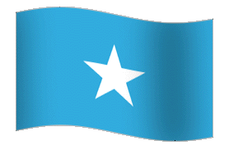
UPCOMING MEETING WORKING PARTY ON TROPICAL TUNA(WPTT18TH AND WORKING THE 07TH WORKING PARTY ON METHODS(WPM07
SOMALIA PAPER
PROBLEMS FACING SOMALI TUNAS

Slide 2
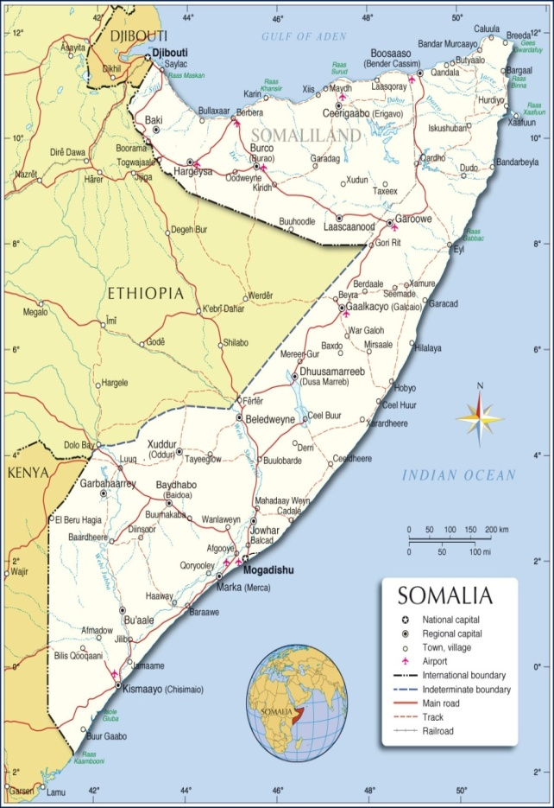
FEDERAL REPUBLIC OF SOMALIA

Slide 3
INTRODUCTION
Somalia is currently recovering from 25 years of civil wars and anarchy which halted functioning of all government institutions including the fishery sector
Somalia has longest coastline of Africa of over 3300km. Despite that no fishery researches were conducted in Somali waters, it is believed to be rich of fishery resources specially tuna and tuna-like fish species in the coastal, EEZ area and beyond

Slide 4
The Somali fishing is governed by monsoon winds. They are southwest and northeast monsoons, during the southwest monsoon (April-September), the Somali current flows northwards along the coast of Africa. In the northeast monsoon (October-March) the Somali current reverses and flows southwards. These current cause seasonal changes influenced by southwest and northeast monsoons

Slide 5
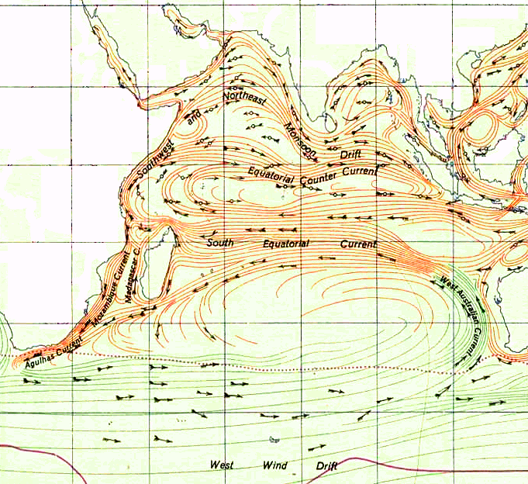

Slide 6
The Somali Current, being the fastest and strongest current in the world reaches the speeds of about 7 knots (8 miles [13 km] per hour).
This huge fast moving water create upwelling, upwelling generates and makes ocean very rich by bring rich cool nutrient water from the ocean bottom to the surface and replaces the warm depleted water. The world’s upwelling places characterize to support the world’s largest fish stocks specially pelagic fish such as anchovies and sardines, these small pelagic fish attract and support large pelagic fish like tunas and tuna-like fish species. This phenomenon make Somali Indian Ocean water the richest place in southern Indian Ocean

Slide 7
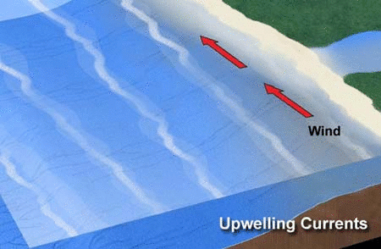
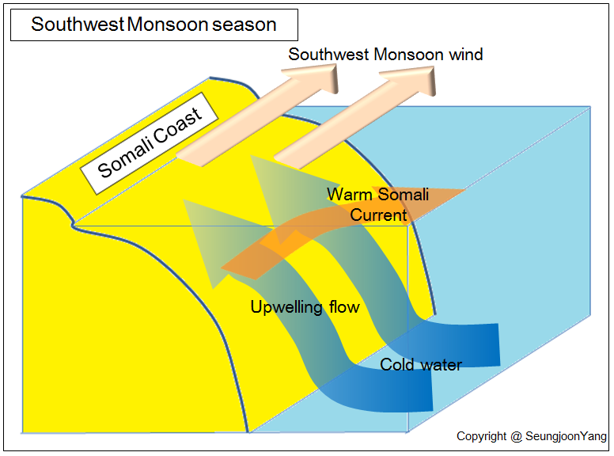

Slide 8
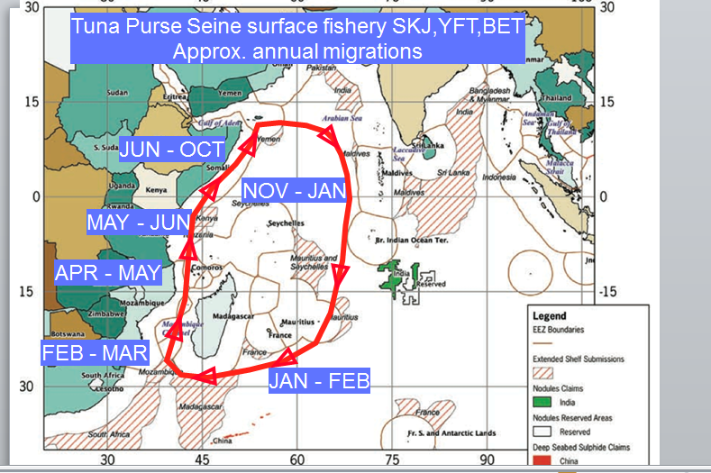

Slide 9
Regardless of this richness Somalia and Somali fisheries remained poor because of the followings:
Lack of proper technology
Lack of industrial fishing fleet operating high seas
Poor management
Lack of means defending our resources
Lack of investment
Poor security

Slide 10
Problems facing Somalia tunas and tuna- like tuna fishes
Illegal, unregulated and unreported fishing activities in Somali waters from neighboring and distant water fishing vessels
Somalis don't even know the current situation of their tunas.
Somali don't known to whom the Somali tunas and tuna like fishes belongs to, because its free for all.
The Somali like and are willing to protect its resources and environment but is lacking the mechanisms of doing these.

Slide 11
No data collection
Lack of surveillance, monitoring and control (mcs) for coastal and industrial fishing
Establishment of Somali fishery authority is not yet finalized

Slide 12
THANK VERY MUCH FOR ATTENTION
ENG. ABDI ALI YARE

