Slide 1



CONSULTATION AND VALIDATION WORKSHOP ON THE DEVELOPMENT OF AN ELECTRONIC MONITORING AND REPORTING INFORMATION SYSTEM
(E-MARIS application)
Understanding the statistical data reporting requirements
Data and Compliance Sections
IOTC Secretariat

Slide 2
Understanding the statistical data reporting requirements
Outline of this presentation
Introduction
  Why? Who? What? When?
Requirements
  Data reporting constraints and specifications
Current state of the art
  Expectations vs. reality
e-MARIS and its implications for CPCs
  Enable proper reporting and increase the level of compliance
References
  Other documents and food for thoughts

Slide 3
Understanding the statistical data reporting requirements
Introduction
Why it is important to report statistical data to the Secretariat?
They are the basis for the assessments of all stocks and for the eventual definition of sound management advices (WP reports);
They are also crucial to evaluate the effectiveness of currently implemented measures and policies as they are in place (e.g. Resolution 17/01);
Who is responsible for their collection and submission?
Detailed data must be provided by the industry to the flag states, for amalgamation and submission by the latter to the Secretariat (Res 15/02);
What should be collected and reported?
Depending on the species and gears considered, as well as on the currently standing resolutions, a number of different data sets might be required (Resolutions 15/01, 15/02 and others);
When should data be reported?
The Secretariat should receive all the mandatory statistical data by June 30th each year. Updates for longline fleets are expected by December 31st

Slide 4
Understanding the statistical data reporting requirements
Requirements
Over the years, a number of different resolutions directly related to data collection and reporting have been defined and implemented by the Secretariat;
Beside the need of setting and improving current data management standards, some of these resolutions were also required to increase the understanding of changes in fishery operations and sensitive species status, as well as addressing new and outstanding issues;
As of today, the main resolutions dealing with data collection and reporting are:
15/01 – On the recording of catch-and-effort data by fishing vessels (…)
15/02 – Mandatory statistical reporting requirements for IOTC CPCs
12/02 – Data confidentiality policy and procedures
Resolutions 15/01 and 15/02 set the standards in terms of how operational data should be collected and reported, while Resolution 12/02 establishes the minimum confidentiality policies to ensure that sensitive data is not publicly disseminated (unless properly aggregated) once it is received by the Secretariat.

Slide 5
Understanding the statistical data reporting requirements
Requirements (continued)
A number of other active Resolutions currently complements the previous three:
17/08 – Procedures on a Fish Aggregating Devices management plan (…)
17/05 – On the conservation of sharks
15/05 – On conservation measures for Striped Marlin, Black Marlin and Blue Marlin
17/01 – On an interim plan for rebuilding the Indian Ocean yellowfin tuna stock (…)
11/04 – On a Regional Observer Scheme
12/04 – On the conservation of marine turtles
12/06 – On reducing the incidental bycatch of seabirds in Longline fisheries
13/04 – On the conservation of cetaceans
13/05 – On the conservation of whale sharks
16/06 – On measures applicable in case of non fulfilment of reporting obligations (…)
Voluntary reporting requirements do also exist that are not related to any specific Resolution (e.g. reporting of fishing crafts, fish prices and socio-economic indicators).

Slide 6
Understanding the statistical data reporting requirements
How do the reporting requirements apply according to current IOTC resolutions
RETAINED
DISCARDED
OBSERVER DATA
Resolution 15/02
Resolution 11/04
IOTC Species
Nominal Catch
Form
1RC
Catch & Effort Forms
3CE / 3AR (3FA / 3SU)
Size & Freq.cy
Form
4SF
Discards
Form
1DI
IOTC Observer templates
ROS e-reporting
Sharks
Voluntary
Other species
Res 13/05
Whale sharks
GN / PS
Res 12/06
Seabirds
LL / GN
Res 13/04
Marine mammals
GN / PS LL
Res 12/04
Marine turtles
PL / GN PS / LL

Slide 7
Understanding the statistical data reporting requirements
Current state of the art
The IOTC Secretariat promotes the adoption of a number of recommended data reporting templates (in Excel format) to facilitate the compilation and submission of the mandatory statistical information by CPCs.
These templates reduce the possibility of mistakes in their compilation, by incorporating updated references to all IOTC standard codes and by adopting basic error checking routines.
Templates for the submission of all mandatory statistical information are available for download from the IOTC web pages, including:
Form 1_RC: Retained catches in live weight
Form 1_DI: Discard levels in live weight or number
Form 2_FC: Number of fishing crafts by type of fishery, craft and size
Form 3_CE / AR: Catch-and-effort in live weight or numbers
Form 3_SU: Number and characteristics of support vessels
Form 3_FA: Number and characteristics of FADs, positive catches in live weight or no.
Form 4_SF: Size data by species and class (length or weight)
Form 7_PR: Average fish prices by type of product, currency and market

Slide 8
Understanding the statistical data reporting requirements
Current state of the art (continued)
Overview of current IOTC forms and corresponding data sets
Form | Dataset | Time resolution | Area resolution | Notes
1_RC* | Retained catches in live weight | Year / Quarter | IO areas (W/E)
1_DI* | Discard levels in live weight or numbers | Year | IO areas (W/E)
3_CE | Catch-and-effort in live weight or numbers | Month | 1°x1° grids | surface fisheries
3_CE | Catch-and-effort in live weight or numbers | Month | 5°x5° grids | longline fisheries
3_AR | Catch-and-effort in live weight or numbers | Month | Any | coastal fisheries
3_FA | FAD numbers, interactions and catches | Month | 1°x1° grids | surface fisheries
3_SU | Number of support vessels and effort (days at sea) | Month | 1°x1° grids | PS fisheries
4_SF | Size-frequency data | Month | 5°x5° grids
* currently subject to revisions

Slide 9
Understanding the statistical data reporting requirements
Current state of the art (continued)
As these data reporting templates are NOT mandatory, the Secretariat has to deal with whatever format is commonly used by CPCs, including – but not limited to – CSV and text files, Word and PDF documents as well as non-standard, proprietary Excel files.
This wide variety of data reporting formats adopted by CPCs has been historically addressed by the Secretariat’s staff through custom validation and data extraction procedures, at the expense of a reduced time to market for the incorporation of the received updates.
Furthermore, many of the mandatory and relevant data reporting constraints (e.g. minimum geographical grid sizes for catch-and-effort and size-frequency information) are not always fulfilled, therefore reducing the effectiveness and completeness of the reported information.
Data submissions are currently performed through personal communication (e-mails) between responsible officers from each CPCs and the Data Section of the Secretariat: this relatively informal approach is asynchronous and depends on the physical availability of the involved entities (i.e. it can happen only during office hours).

Slide 10
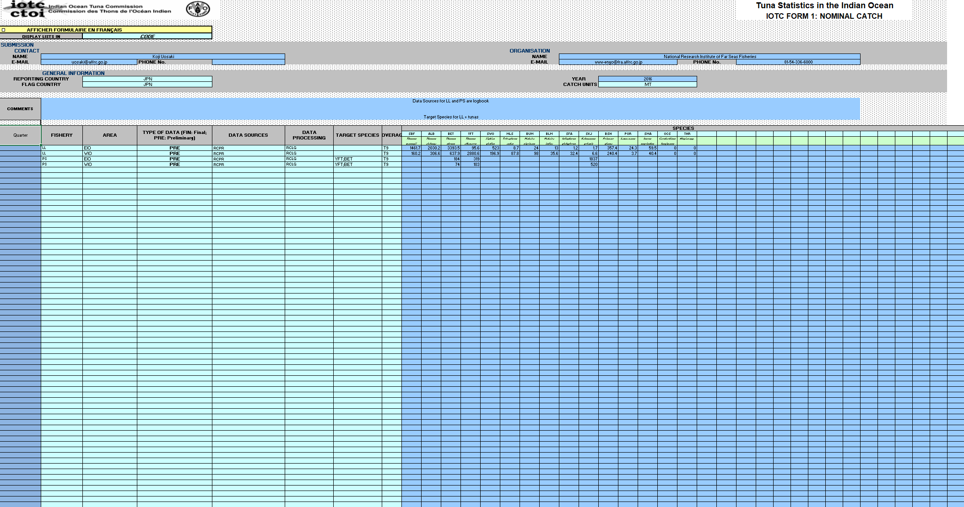
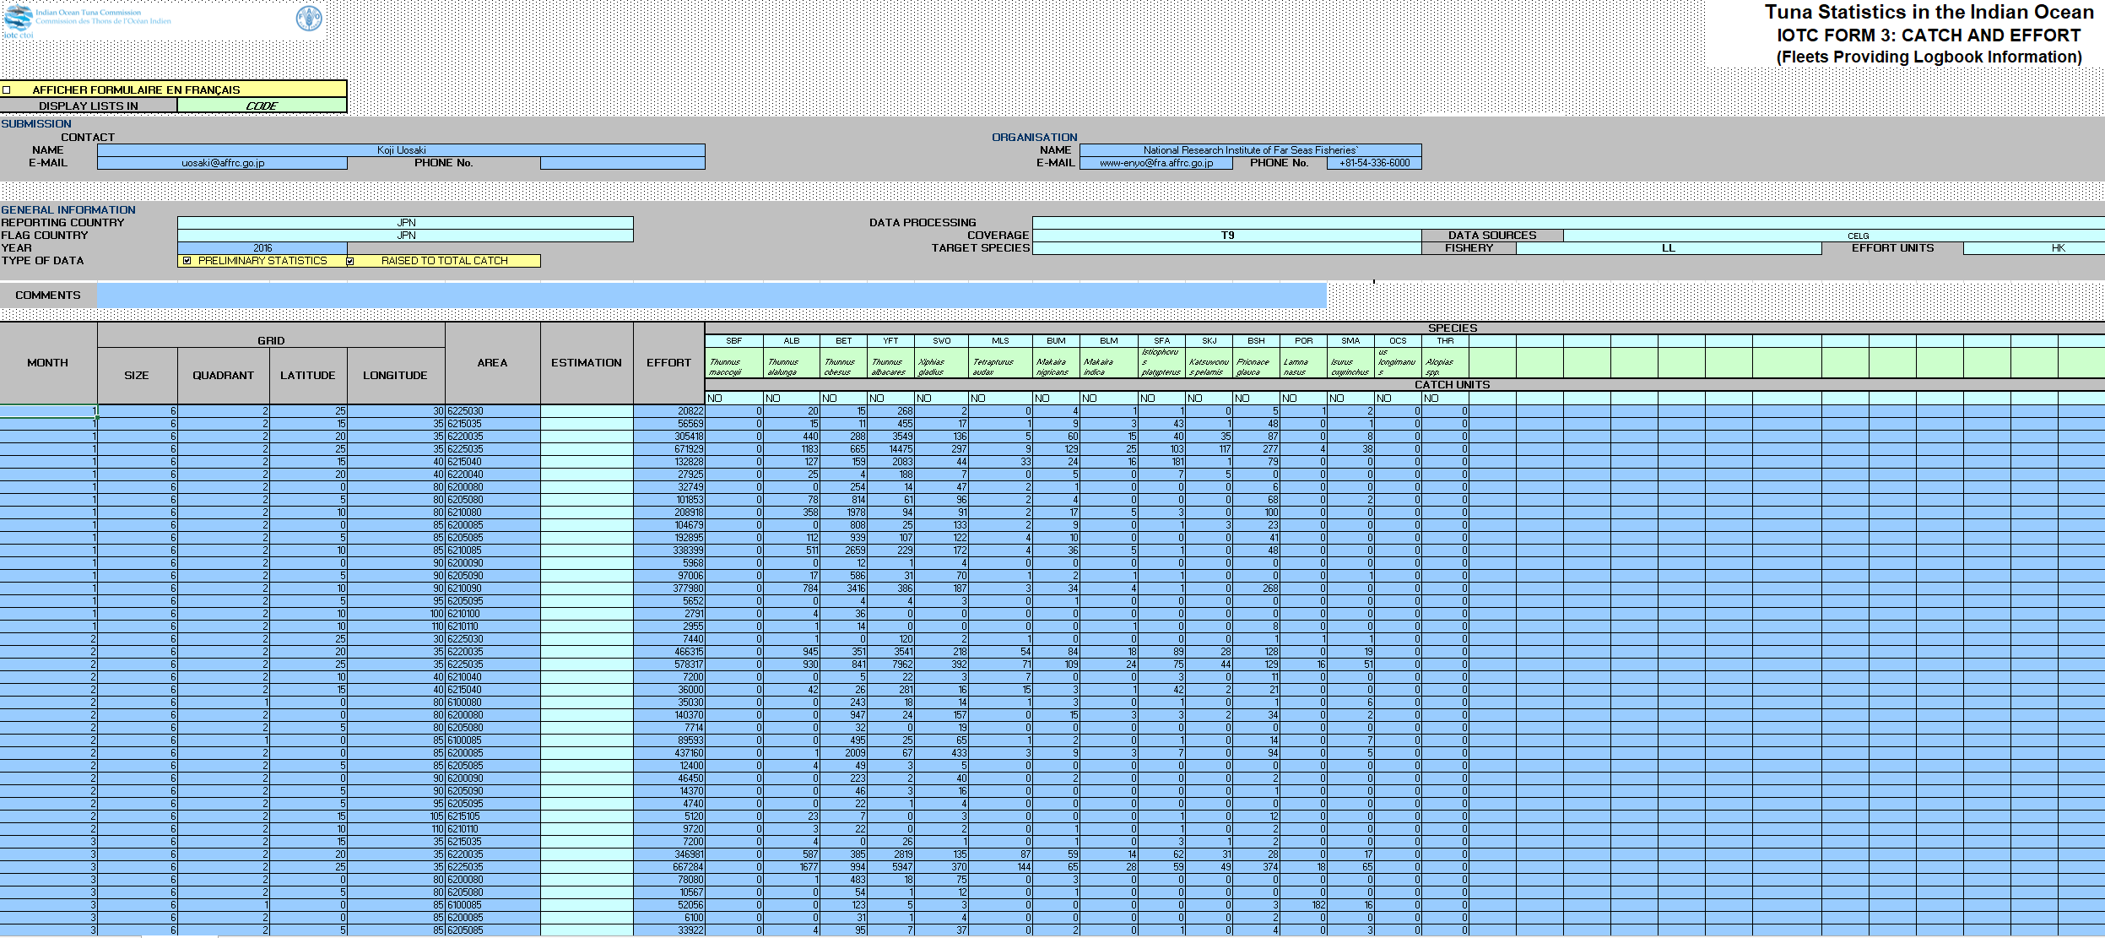
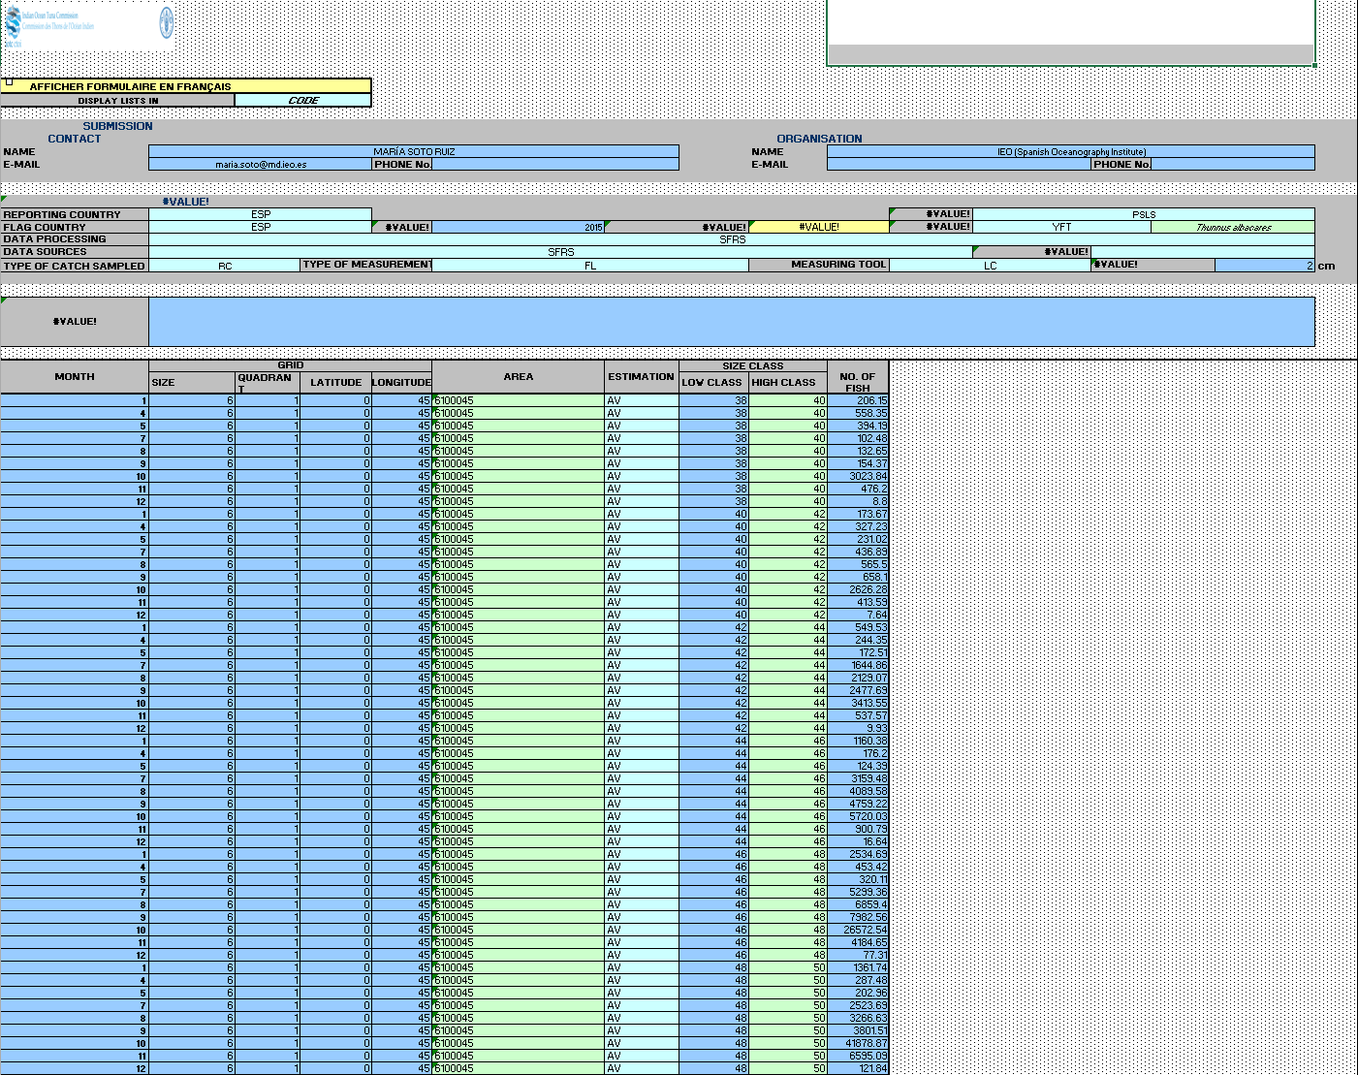
Understanding the statistical data reporting requirements
Current state of the art (examples – standard IOTC)

Slide 11
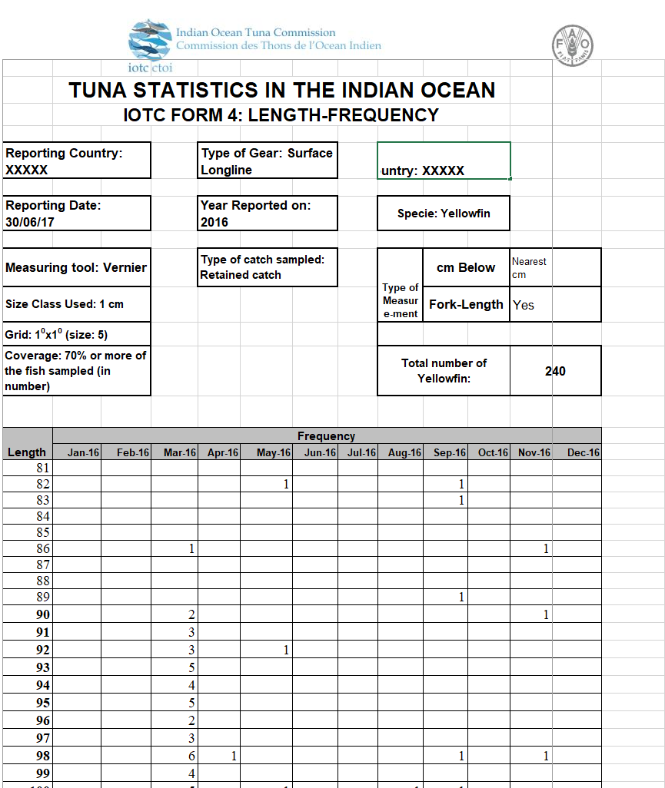
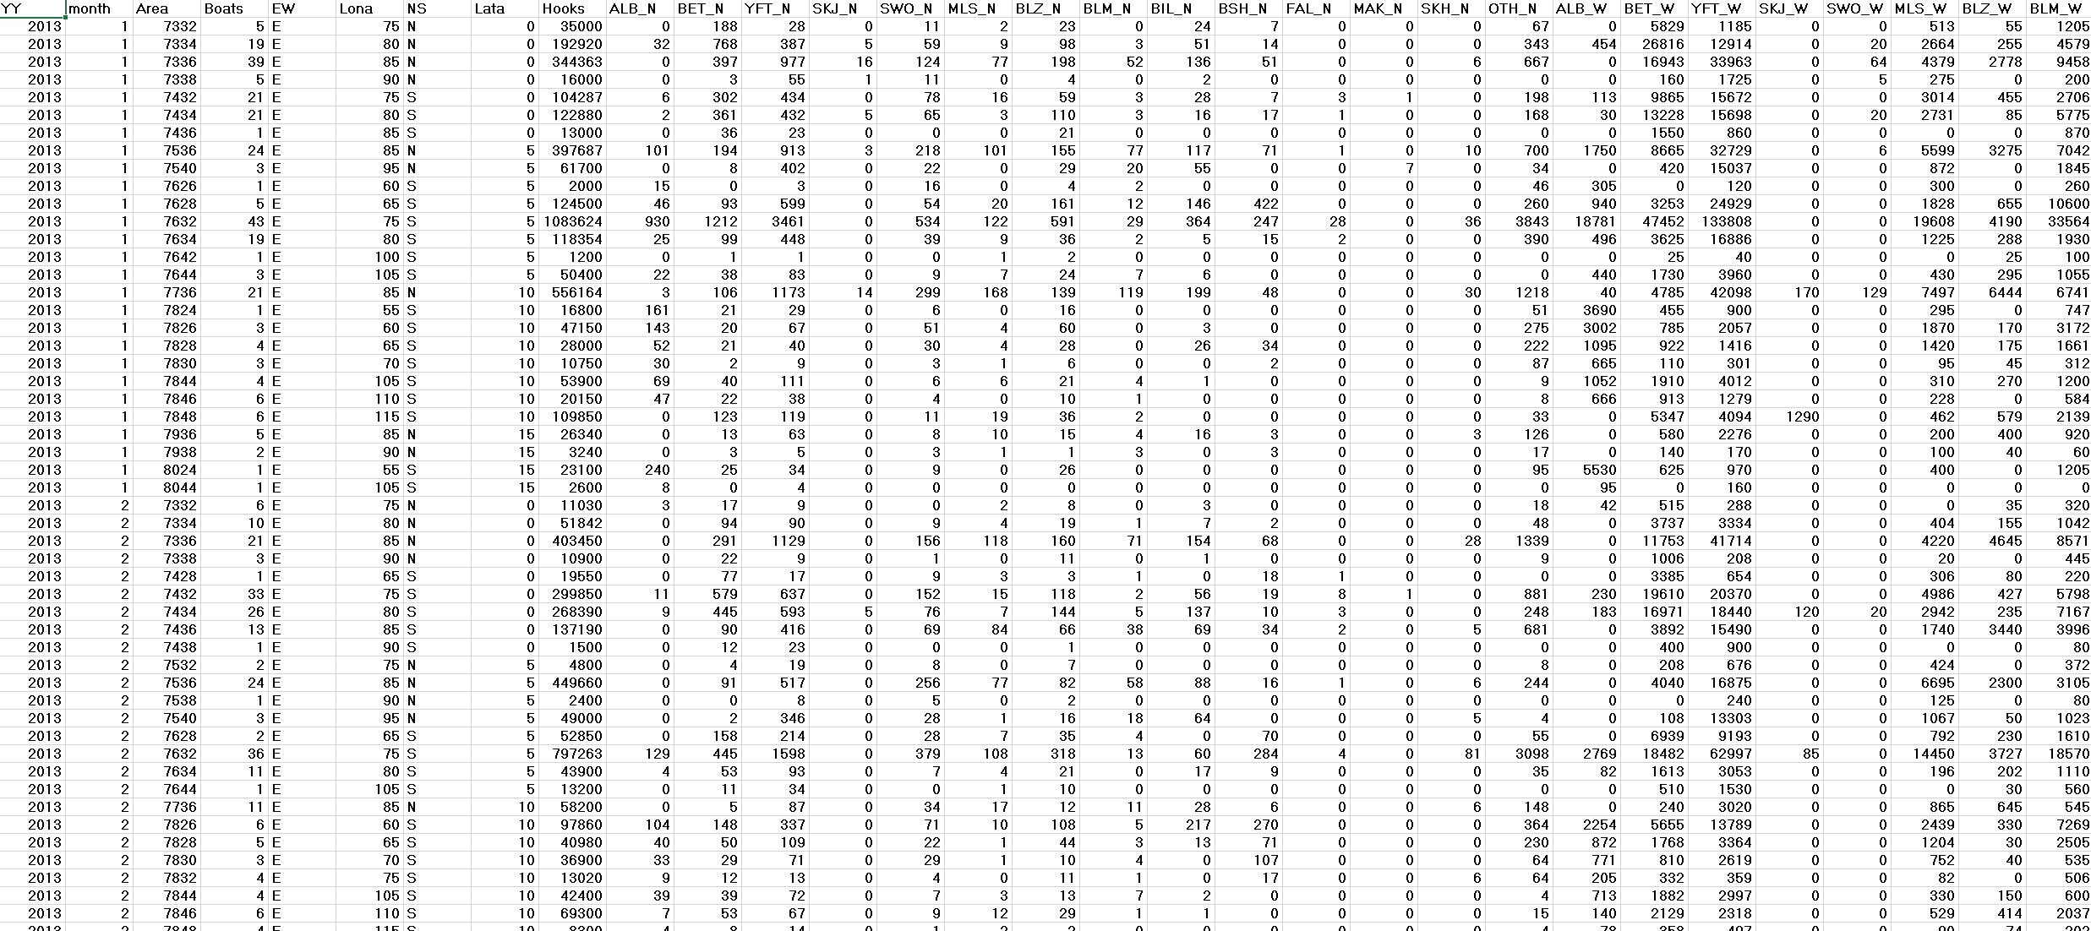
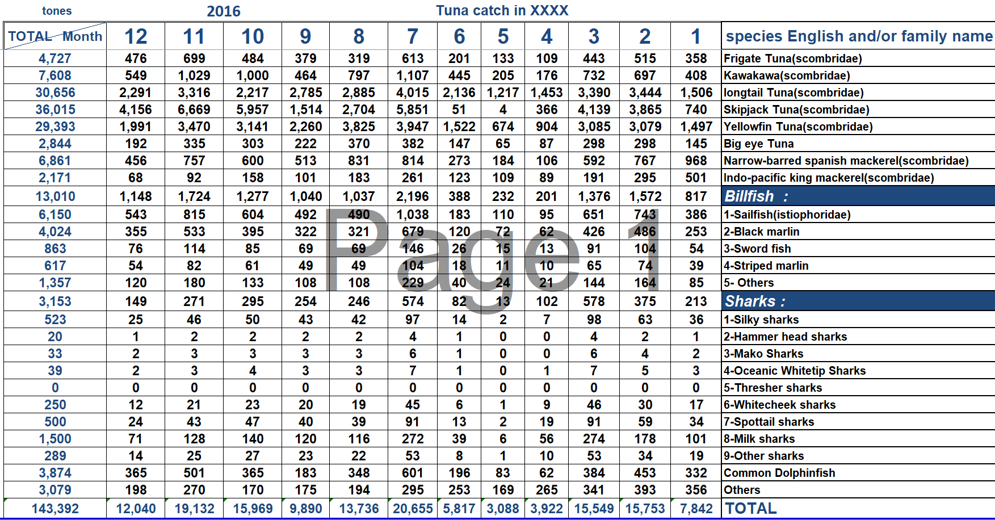

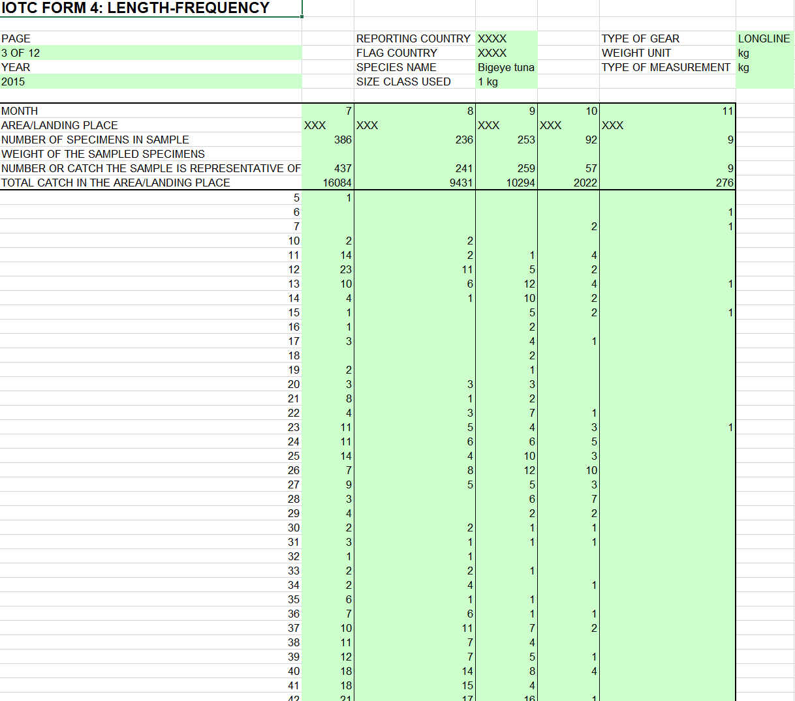
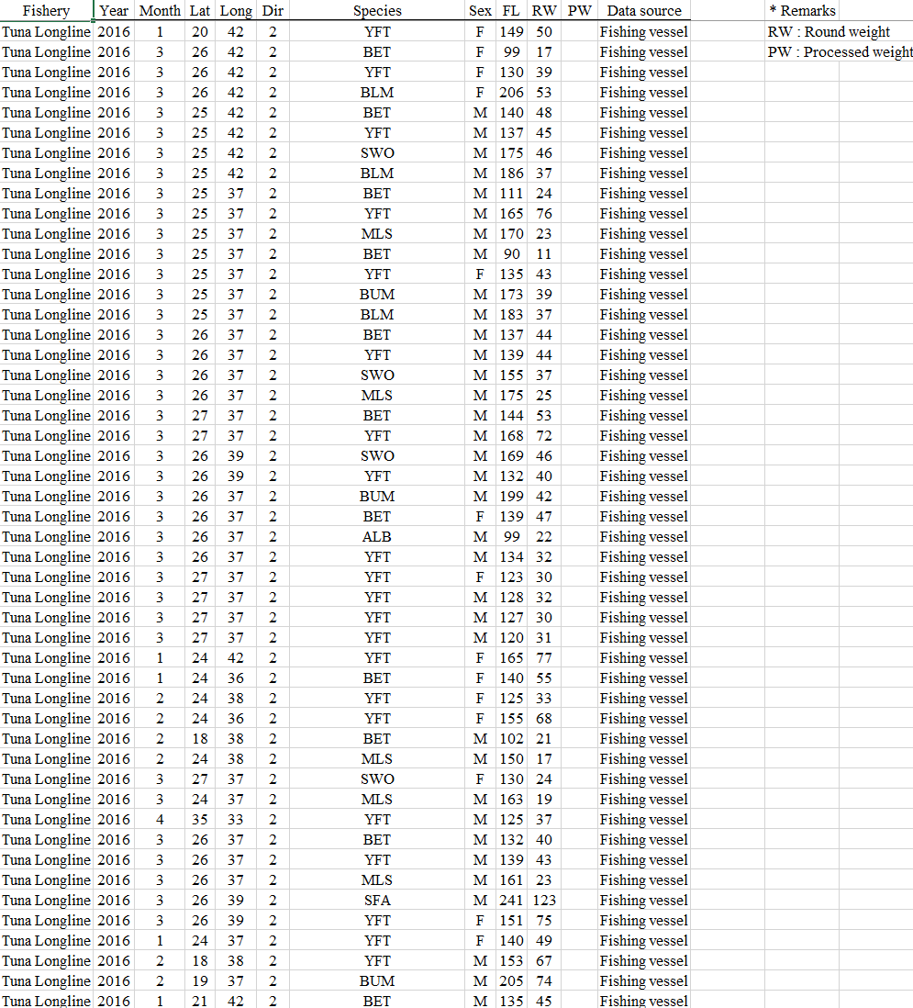
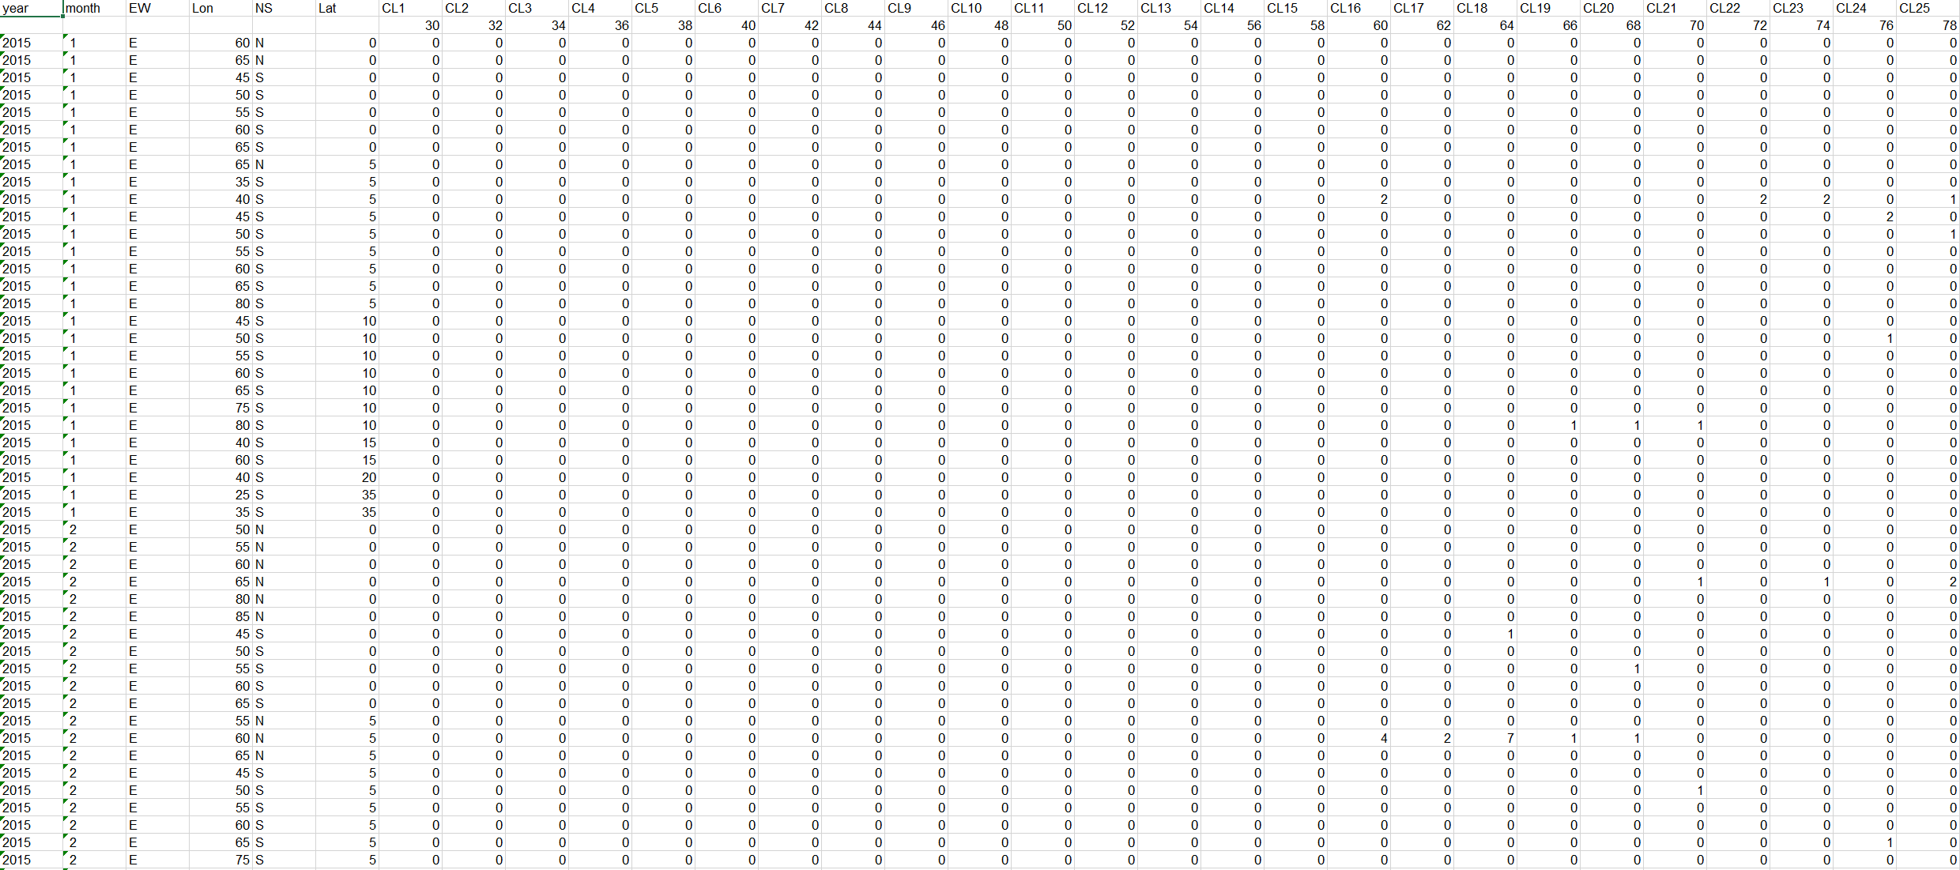
Understanding the statistical data reporting requirements
Current state of the art (examples - non standard)

Slide 12
Understanding the statistical data reporting requirements
e-MARIS: implications for CPCs
e-MARIS aims at fulfilling the recommendation – originating from the Performance Review Panel – that IOTC “further develop an online reporting tool to facilitate reporting by CPCs and to support the Secretariat through the automation of identification of non-compliance” (PRIOTC02).
It is the first concrete attempt at streamlining and harmonizing the data reporting process for both compliance and statistical purposes and – as such – it requires strong collaborative efforts from all stakeholders.
The IOTC Secretariat is well aware of the multiple data collection and data reporting issues common to many CPCs, and also acknowledges the inherent limitations in the current standard forms for statistical data reporting.
Yet, e-MARIS is aiming at enabling all CPCs to self-report all required information and get as much (automated) feedback as possible at the earliest stage of the process, thus reducing the need for human intervention to a minimum once the system is successfully in place.
For this to happen in the foreseeable future, it is crucial to define standard reporting formats and processes and ensure their adoption by all CPCs.

Slide 13
Understanding the statistical data reporting requirements
e-MARIS: implications for CPCs (continued)
Member countries should assess their current state-of-the-art – in terms of mandatory statistical data collection and reporting – by asking themselves the following questions:
  “Can we collect the mandatory statistical information down to the level of detail required by the different IOTC resolutions?”
  “Can we timely submit this information to the IOTC Secretariat using the recommended data submission forms?”
If the answer to any of the two questions is NO, and it is not likely to change in the near future, then there is a problem that NEEDS to be solved.
In such circumstances, proper actions at national level should be taken, while at the same time consulting with the Secretariat in due time to ensure that the minimum required level of reporting could be reached (e.g. through capacity building activities and / or on-site data support and compliance missions).

Slide 14
Understanding the statistical data reporting requirements
e-MARIS: implications for CPCs (continued)
The two approaches compared
Requirements / actions | Current process | e-MARIS
Data reporting deadlines | Circulars and reminders | Automated e-mails
Availability | Offline (asynchronous) | Online (24/7)
Data submissions | e-mail attachment | File upload
Data updates | e-mail attachment | File upload
Data validation feedback (QA) | e-mail / personal comm. | Report upon upload
Data container (file types) | Any (including IOTC forms) | Fixed (IOTC forms*)
CPC data compliance status | Updated before COM | Realtime
* Or any other standard format that might be deemed as adequate by the e-MARIS stakeholders

Slide 15
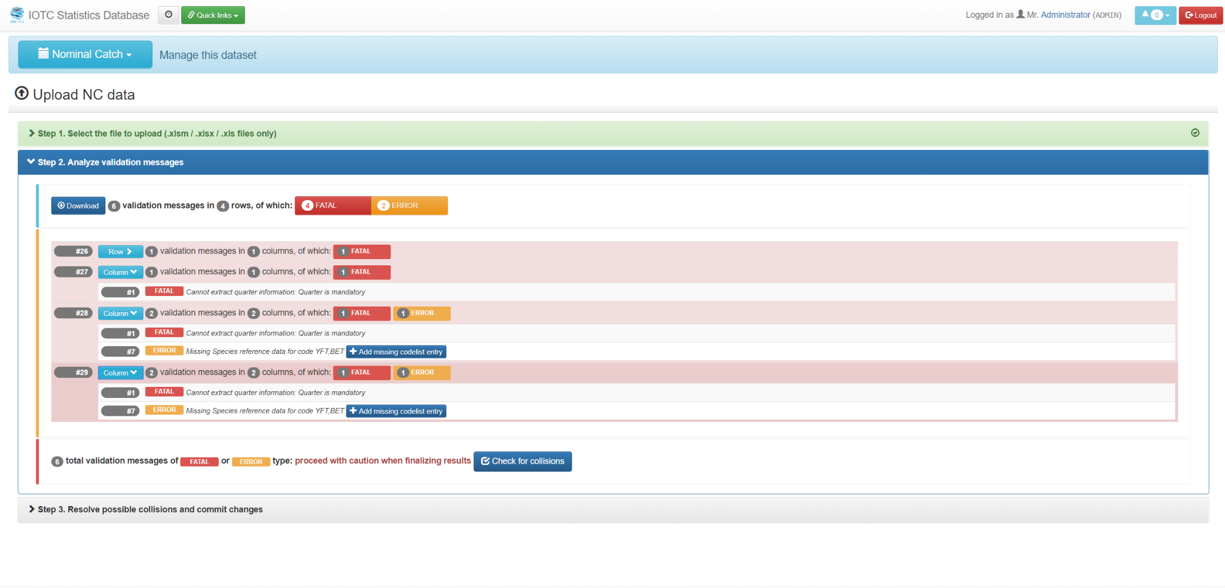
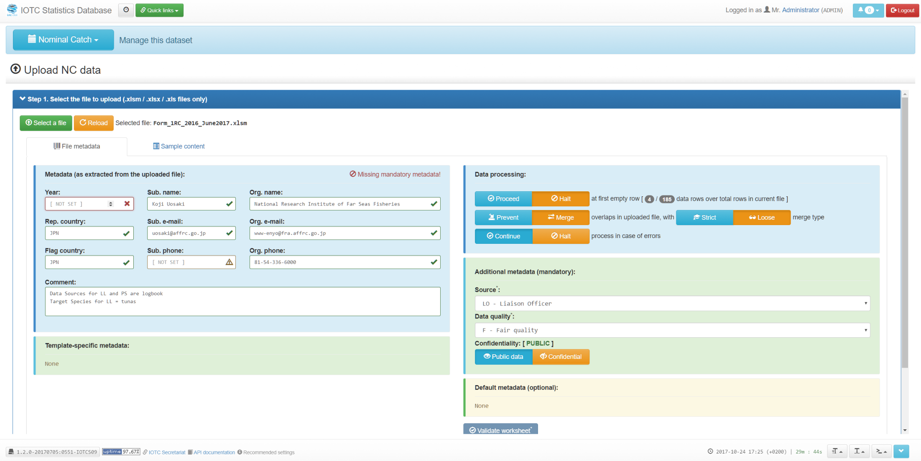
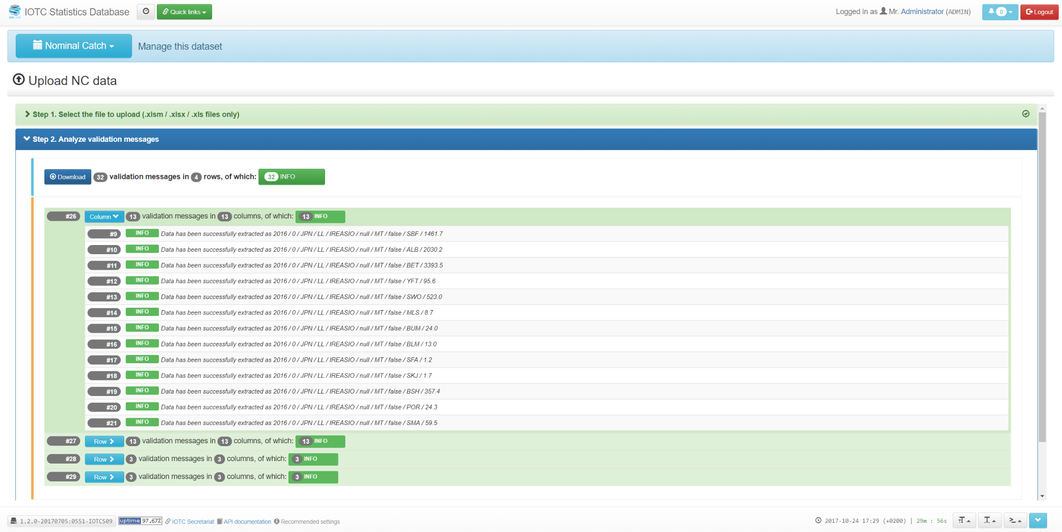
Understanding the statistical data reporting requirements
e-MARIS: integration with the IOTC SWS

Slide 16
Understanding the statistical data reporting requirements
e-MARIS: implications for CPCs (continued)
Report of the 19th Session of the Working Party on Tropical Tuna:
(Para. 20): “ACKNOWLEDGING the substantial gaps in reporting of mandatory IOTC datasets by many CPCs to the IOTC Secretariat, which increases the uncertainty of stock assessments and management advice based on these data, the WPTT strongly RECOMMENDED the Commission strengthen the penalty mechanisms adopted in Resolution 16/06 On measures applicable in case of non-fulfilment of reporting obligations in the IOTC to improve compliance by CPCs in terms of the submission of basic fishery data in accordance with Resolution 15/01 and 15/02” (the text in the final adopted report may slightly vary)
!!! e-MARIS !!!

Slide 17
Understanding the statistical data reporting requirements
References
Guidelines for the reporting of fisheries statistics to the IOTC
    http://www.iotc.org/sites/default/files/Guidelines_Data_Reporting_IOTC1.pdf
Forms for the submission of requested fisheries statistics
    http://www.iotc.org/data/requested-statistics-and-submission-forms
IOTC Resolution 12/02 – “On data confidentiality policy and procedures”
  http://www.iotc.org/cmm/resolution-1202-data-confidentiality-policy-and-procedures
IOTC Resolution 15/02 – “On mandatory statistical requirements”
    http://www.iotc.org/cmm/resolution-1002-mandatory-statistical-requirements-iotc-members-and-cooperating-non-contracting
IOTC Resolution 16/06 – “On measures applicable in case of non-fulfilment of reporting obligations in the IOTC”
    http://www.iotc.org/cmm/resolution-1606-measures-applicable-case-non-fulfilment-reporting-obligations-iotc
Implementation sheets for current IOTC Resolutions
    http://www.iotc.org/cmm/resolution-1002-mandatory-statistical-requirements-iotc-members-and-cooperating-non-contracting

Slide 18

Understanding the statistical data reporting requirements
Thank you for your attention!
Questions?

