Slide 1


IOTC fisheries identification
IOTC PURSE SEINE FISHERIES REPORTING WORKSHOP
Victoria, Seychelles, 16 – 19 March 2026
IOTC-Secretariat@fao.org

Slide 2

Background
Considering the overcoming issues encountered by several CPCs when attempting to categorize their fisheries for IOTC reporting purposes, on the 18th Working Party on Data Collection and Statistics (WPDCS18) the Secretariat presented a new approach to the definition and codification of fisheries catching tuna and tuna-like species in the Indian Ocean

Slide 3
New approach to define IOTC Fisheries
IOTC Fisheries definition combines concepts from the fishing effort domain (fishing gear, fishing ground, and fishing mode) with concepts from the catches’ domain (target species) and that by doing so it can accurately describe fishing practices for groups of vessels and be used to characterize sub-units within a fishery.
Notes:
The IOTC Secretariat reviewed the existing literature (including the latest ISSCFG classifications; FAO 2016) and re-assessed the fisheries statistical data submissions received from its CPCs in the last decade to determine the most common factors (gears, gear configurations, fishing modes, and target species) that could uniquely identify the Indian Ocean fisheries according to the definitions.

Slide 4
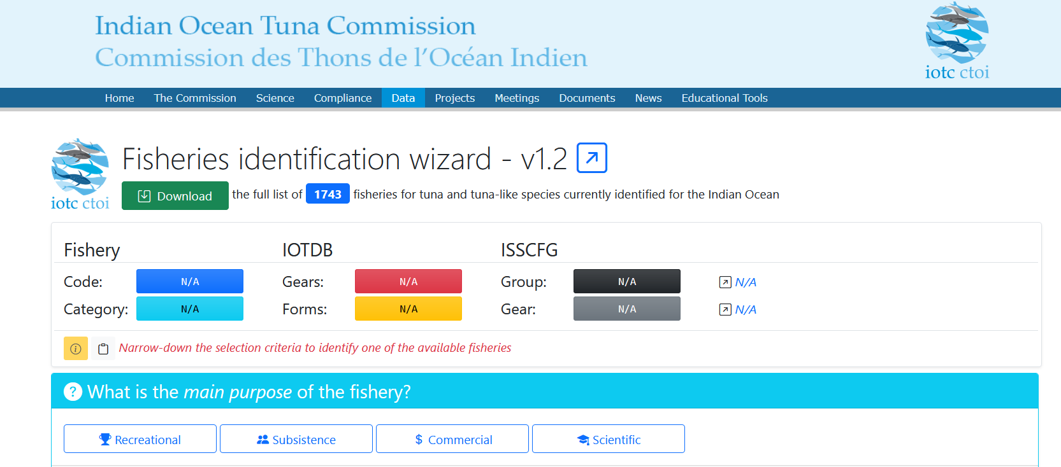

Slide 5
The definition of fishery in the IOTC are function of:
(i)Purpose of the fishery,
(ii) Area of operation,
(iii) category of length overall,
(iv) gear category,
(v) gear used to catch the fish,
(vi) specific configuration of the gear used to catch the fish,
(vi) fishing mode, and
(viii) target species

Slide 6

(i) purpose of the fishery:
recreational, i.e., the fish is caught for recreational purposes only
subsistence, i.e., the fish is exclusively consumed by the fishermen and their households
commercial, i.e., the fish is sold at the landing site or at a market, exported, or sold to processing / canning factories
scientific, i.e., the fishery only operates to collect scientific information or support the training of scientists and fishermen

Slide 7
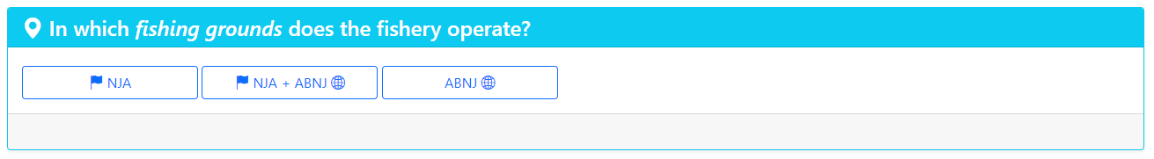
(ii) area of operation of the vessels engaged in the fishery:
NJA, i.e., vessels operate exclusively within areas under national jurisdiction of their flag state (territorial sea, contiguous zone as well as EEZ waters)
NJA and ABNJ, i.e., vessels operate in areas under national jurisdiction as well as in areas beyond national jurisdiction of their flag state (i.e., high seas or areas under national jurisdiction of other coastal states)
ABNJ, i.e., vessels operate exclusively in areas beyond national jurisdiction of their flag state (i.e., high seas or areas under national jurisdiction of other coastal states)

Slide 8
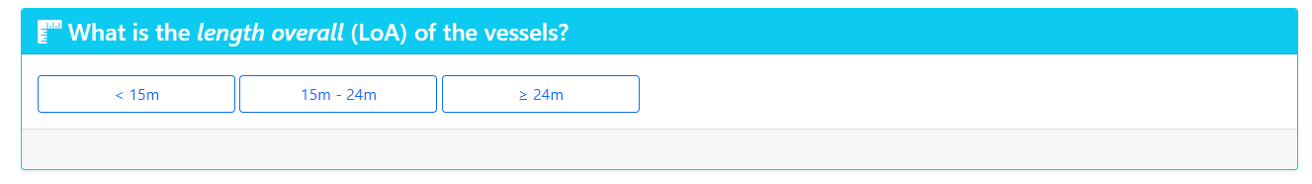
(iii) category of length overall (LoA) of the vessels engaged in the fishery:
LoA < 15 m
15 m ≤ LoA < 24 m
LoA ≥ 24 m

Slide 9
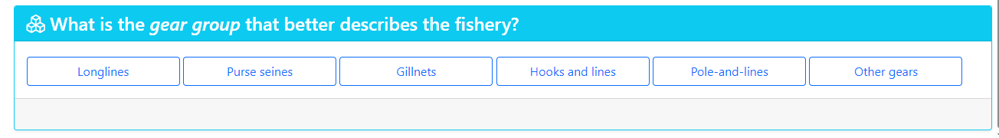
(iv) gear category; mapped by gear groups according to the ISSCFG categorization:
Purse seines, includes purse seines and ringnets, i.e., surrounding nets without purse seines
Gillnets, includes set gillnets, drift gillnets and encircling gillnets
Hooks and lines, includes manual and mechanized handlines, vertical lines and trolling lines
Longlines, includes set longlines, drifting longlines and longlines (nei)
Pole-and-lines, includes manual and mechanized pole-and-lines
Other, a subset of seine nets, trawls, lift nets, falling gear, traps, and miscellaneous gear

Slide 10
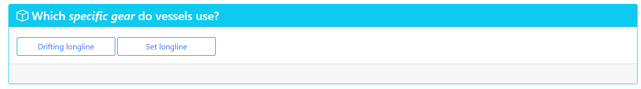

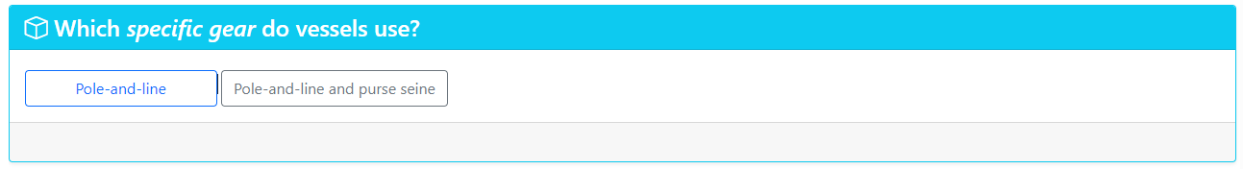
(v) gear used to catch the fish
Mapped on the latest ISSCFG gear codes, and more specifically on those belonging to the selected gear category GC

Slide 11
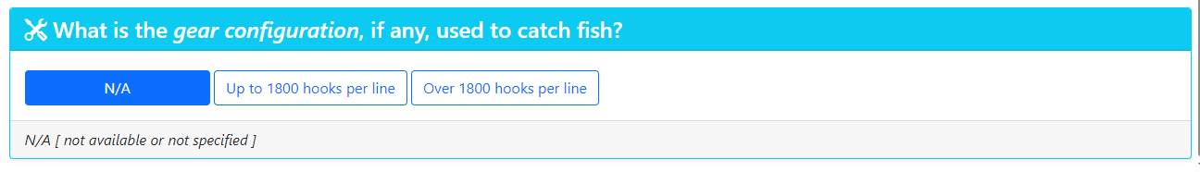
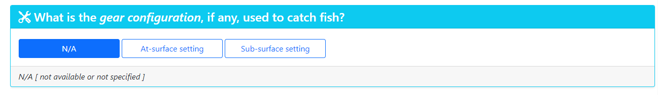
(vi) specific configuration of the gear used to catch the fish (optional)
Chosen from an ad hoc classification whose possible values are determined by the specific gear G selected among those available for the gear category GC
Applies to longline and gillnet

Slide 12
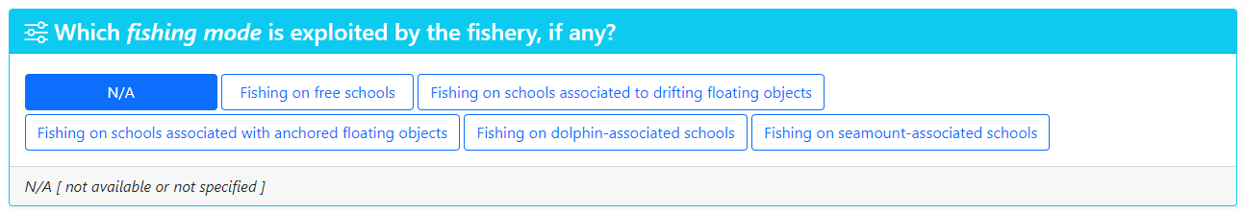
(vii) fishing mode (optional)
Chosen from an ad hoc classification whose possible values are determined by the specific gear G selected among those available for the gear category GC
Applies to purse seiner, hooks and lines and pole and lines

Slide 13
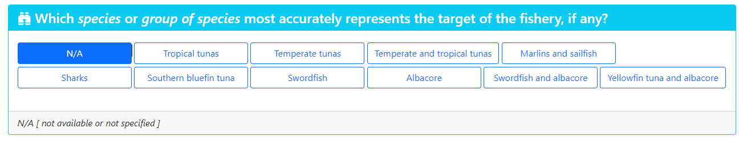
(viii) target species (optional)
the species that most accurately represent(s) the target of the fishery; chosen from an ad hoc classification

Slide 15
Thank you for your attention!
IOTC-Secretariat@fao.org

