Slide 1


data validation process
IOTC PURSE SEINE FISHERIES REPORTING WORKSHOP
Victoria, Seychelles, 16 – 19 March 2026
IOTC-Secretariat@fao.org

Slide 2

IOTC Data validation system is designed to allow users to self-assess the quality of their data by checking that all mandatory elements have been included and that all reference codes have been used correctly.
Each form must be uploaded to the correspondent validator link when completed
The tool will provide an overview of the analysis carried out on the content.

Slide 3
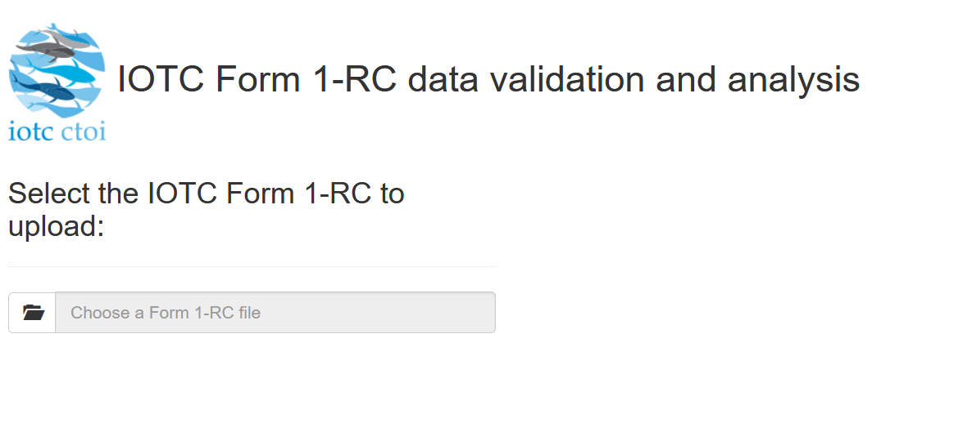

Slide 4
The output of the validation process includes a main box message with flaps of validation messages, ranging from summary information messages to increasing levels of identified issues messages provided in additional flaps. A validation-colored summary box (left bottom), related with the level of issues message is also provided indicating if the form could be successfully processed or need further revision before to be submitted to the IOTC.
When a form is fully filled, and all the mandatory data were included according to the IOTC standard an INFO message will be provided including a summary of the processed information and a validation summary message indicating that the form provided can be successfully processed and submitted to the IOTC

Slide 5
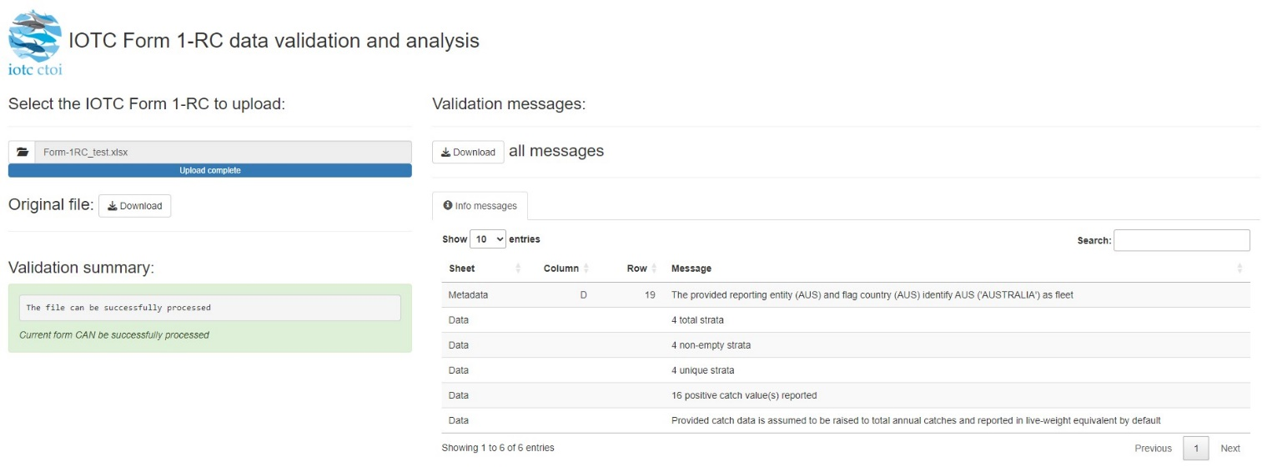
INFO message
Including a summary of the processed information the validation summary message indicates that the form submitted can be successfully processed

Slide 6
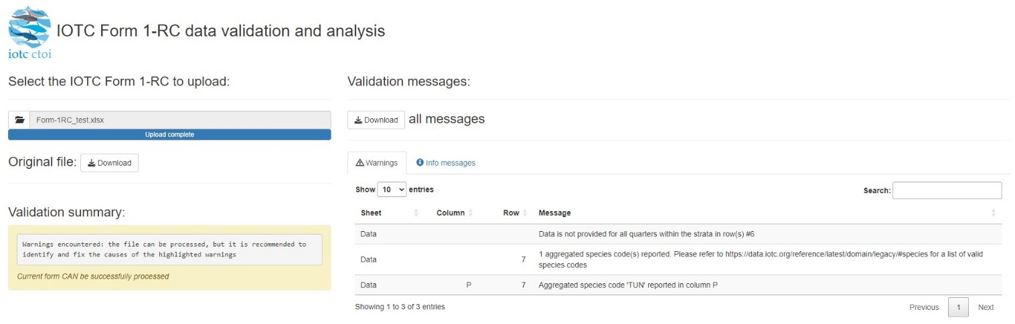
WARNING message
indicates something that will not prevent the form to be processed, although its content is less than optimal.

Slide 7
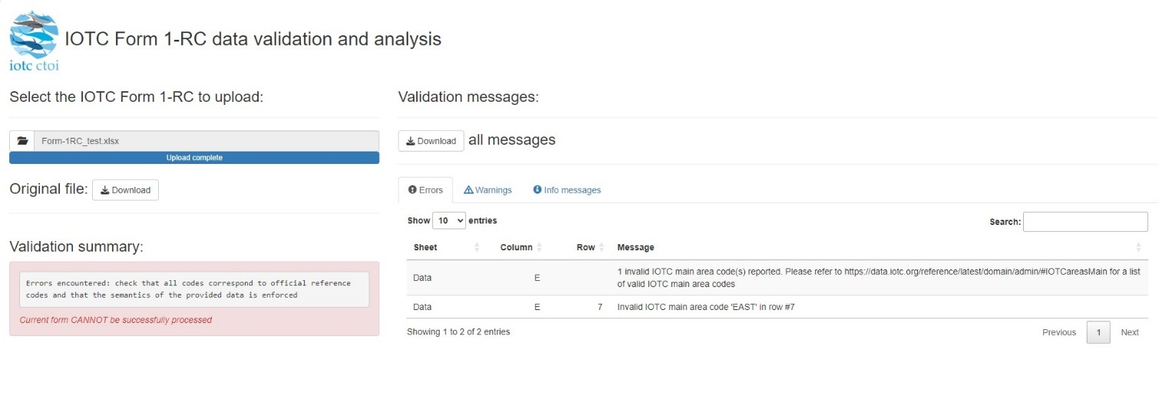
ERROR message
When a form is uploaded with missing mandatory data (both in the metadata and data worksheets) or empty columns or rows (in the data worksheets), or with wrong codes for a particular row or strata
This form cannot be successfully processed until the highlighted errors be reviewed and amended as is showed in the validation summary message.

Slide 8
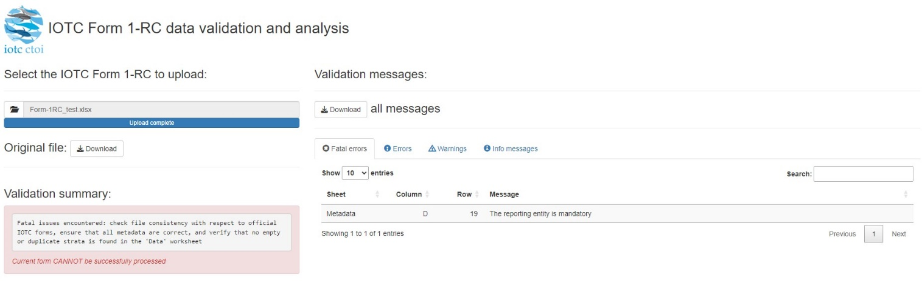
FATAL message
Indicates something that will prevent reading the content of the file, e.g., wrong type of file uploaded, presence of empty rows / columns, or no fleet identified for the provided reporting entity / vessel flag.

Slide 10
Thank you for your attention!
IOTC-Secretariat@fao.org

