Slide 1
Overview of the availability of Purse seine fisheries Datasets

Slide 2
Purse seine fisheries of the IOTC regions
This presentation highlights the availability of large‑scale industrial purse seine fisheries datasets from 2020 to 2024, presenting summarized reporting data compiled in accordance with the established requirements for purse seine fishing operations.

Slide 3
Purse seine fleets
Historically, several distant‑water nations, including Belize, the Philippines, Japan, the former Soviet Union, Iran, and Thailand, operated large-scale industrial purse seine vessels in the Indian Ocean.
Today, nine countries maintain large industrial purse seine fleets, while one additional country participates through chartered vessels:
  European Union
      France (1980)
      Italy (2015)
      Spain (1984)
  Kenya (2024)
  Korea, Rep (2012)
  Mauritius (1979)
  Oman (2022)
  Seychelles (1991)
  Tanzania (2022)
  Mozambique (chartering since 2023)

Slide 4
Reporting status
The retained catch of the main IOTC species, primarily tropical tunas, is well reported across all fleets.
Geo referenced catch and effort data remain challenging for some fleets, particularly newer entrants.
Geo referenced size frequency data are the least available, with certain fleets either unable to provide them or lacking access to the necessary information.
Type | 2020 | 2021 | 2022 | 2023 | 2024
Retained catch data | 6C; 3N/A | 6C; 3N/A | 8C; 1N/A | 8C; 1N/A | 8C; 1P/C
Catch and effort data | 6C; 3N/A | 6C; 3N/A | 6C; 2N/A; 1N/C | 7C; 1N/A; 1N/C | 7C; 2P/C
Size-frequency data | 2C; 3P/C; 1N/C; 3N/A | 2C; 3P/C; 1N/C; 3N/A | 2C; 3P/C; 3N/C; 1N/A | 1C; 5P/C; 2N/C; 1N/A | 3C; 3P/C; 3N/C

Slide 5
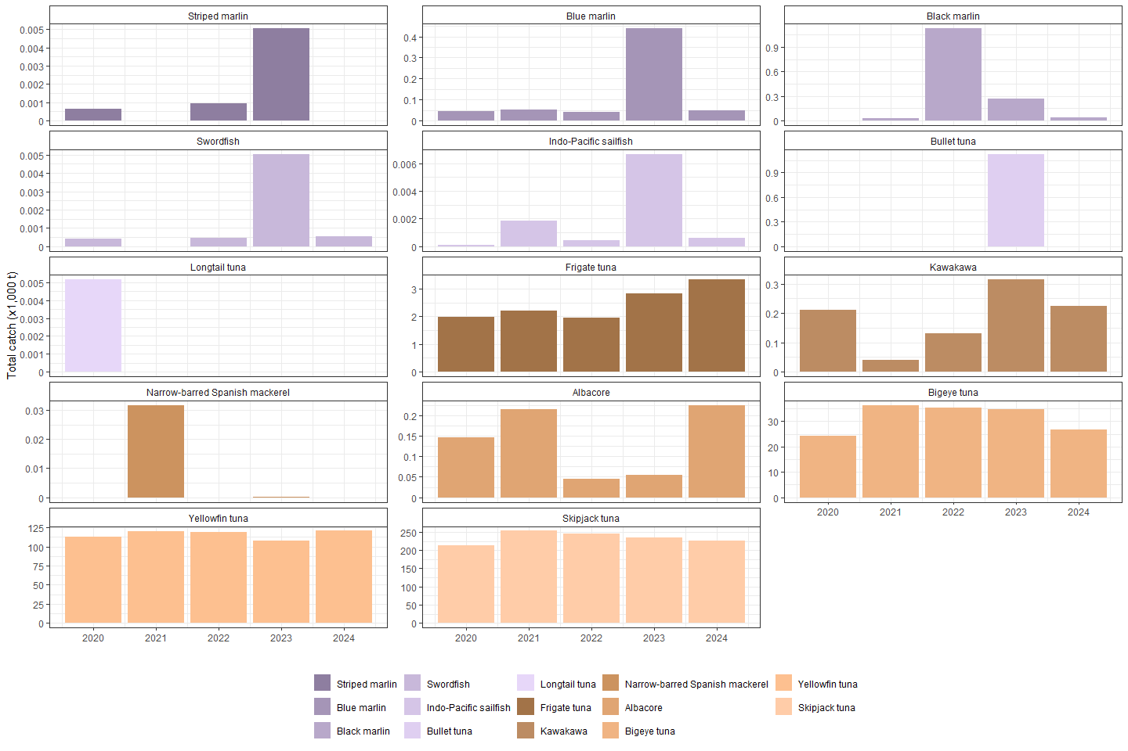
Overview of Purse seine catch by species
Retained catches by species show a clear upward trend over the past five years.
Yellowfin (average: 116,341 t) and skipjack (average: 235,336.9 t) tuna catches remained stable
Bigeye tuna catches fluctuated over the years (average: 31,487.58 t)
Increasing reporting of bycatch species (incl neritics & billfish)
Cumulative time series of annual retained catches (metric tonnes; t) by species as reported by Purse seine fleets for the period 2020-2024

Slide 6
Overview of number of active Purse seine and supply vessels
In 2024, the number of purse seine vessels increased, reflecting the expansion of fleets engaged in purse seine fishing operations.
Gear | 2020 | 2021 | 2022 | 2023 | 2024
Purse seine | 51 | 46 | 45 | 42 | 54
Supply vessel | 12 | 12 | 11 | 11 | 11

Slide 7
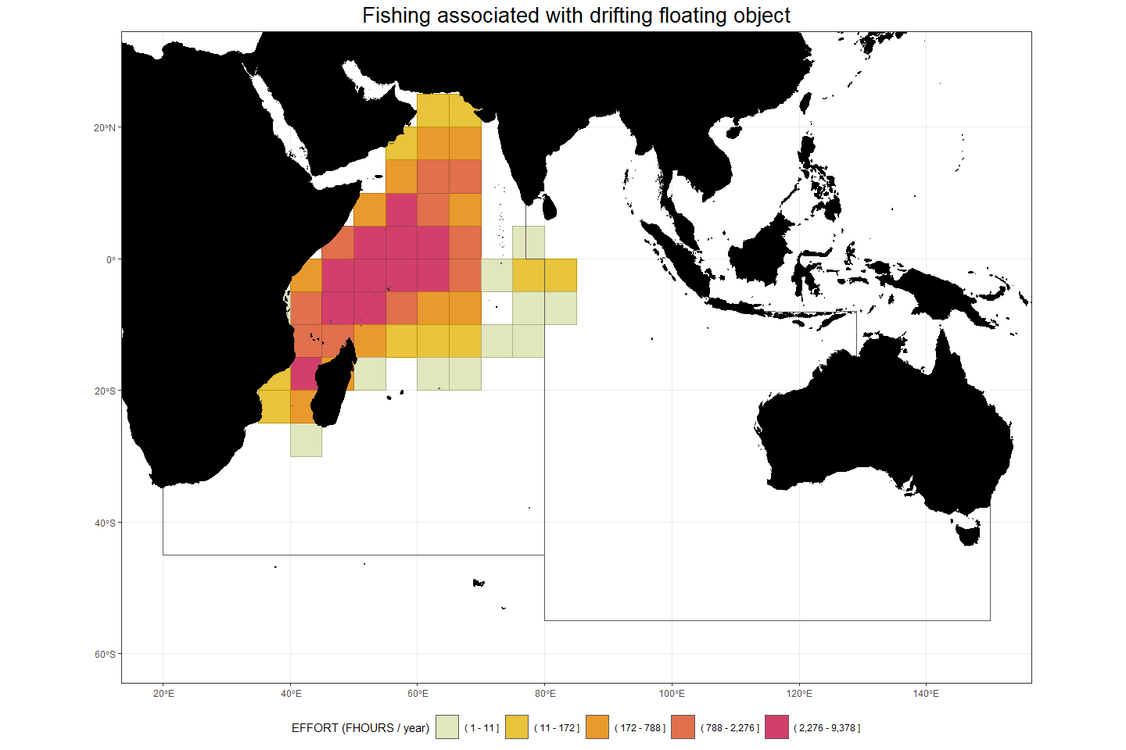
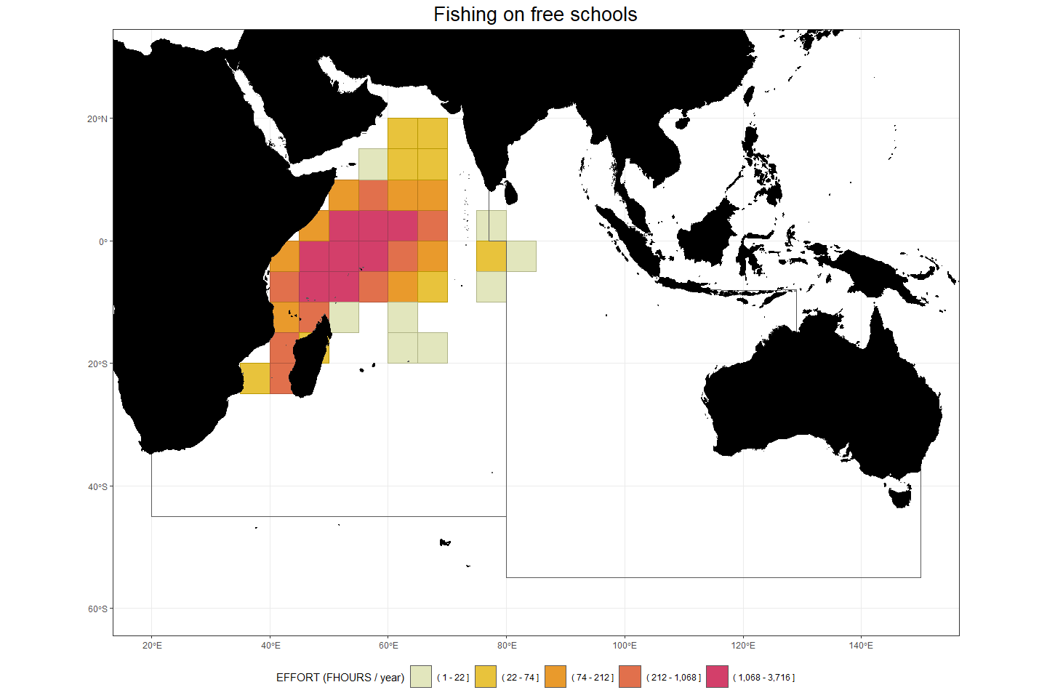
Geo-referenced catch and effort distribution
Geo-referenced effort information indicates most activities of these vessels in the Western Indian Ocean

Slide 8
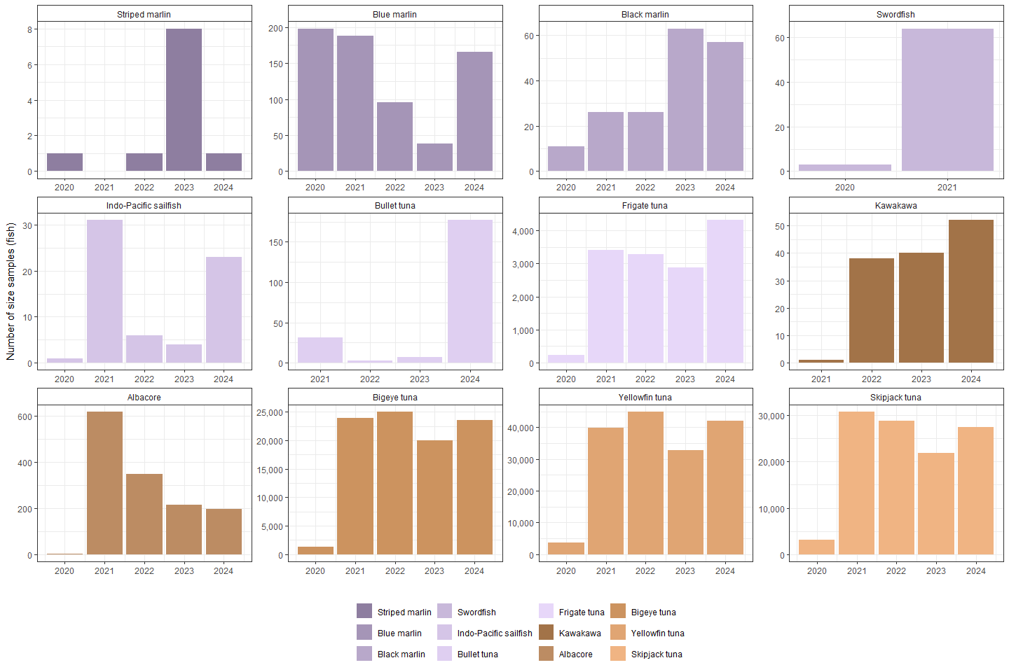
Availability of geo-referenced size frequency - IOTC species
Sampling intensity differs among fleets, and certain fleets are unable to collect size‑frequency data.
Sampling is more comprehensive for targeted species compared to non‑targeted IOTC species
The reduced coverage observed in 2020 was a direct consequence of the disruptions caused by the COVID‑19 pandemic

Slide 9
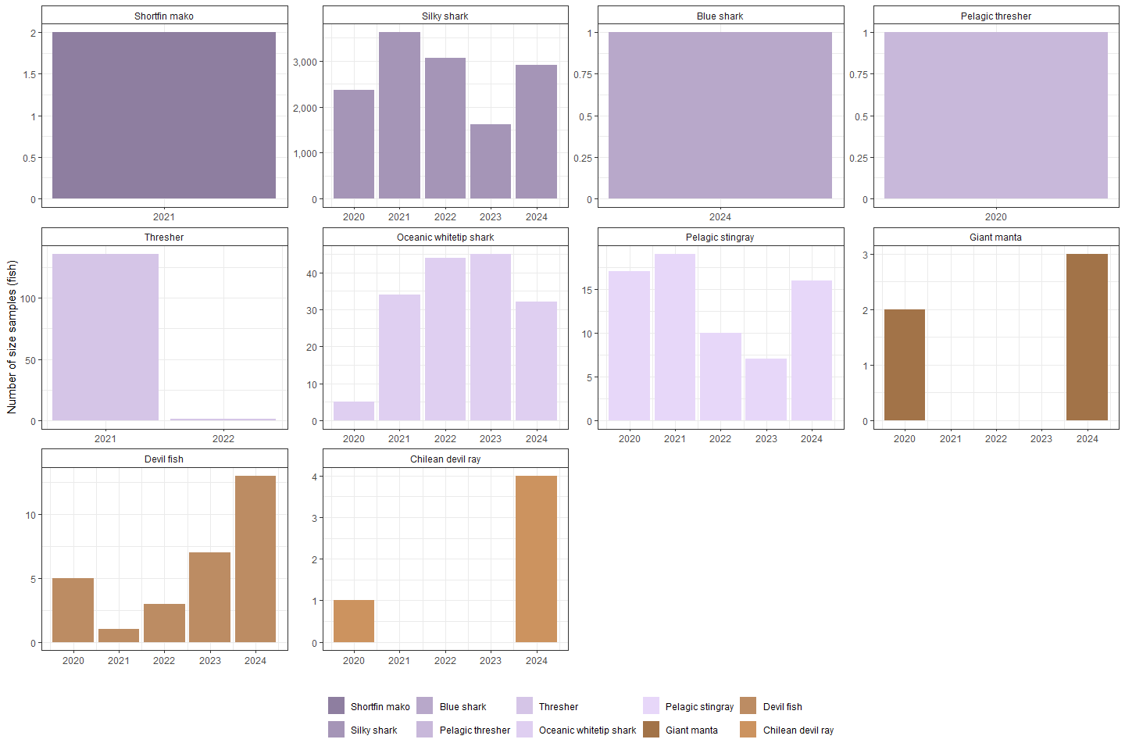
Availability of geo-referenced size frequency - Shark species
Observers’ onboard vessels, collected size‑frequency data encompass certain shark species, notably the Silky shark, which is the most reported

Slide 10
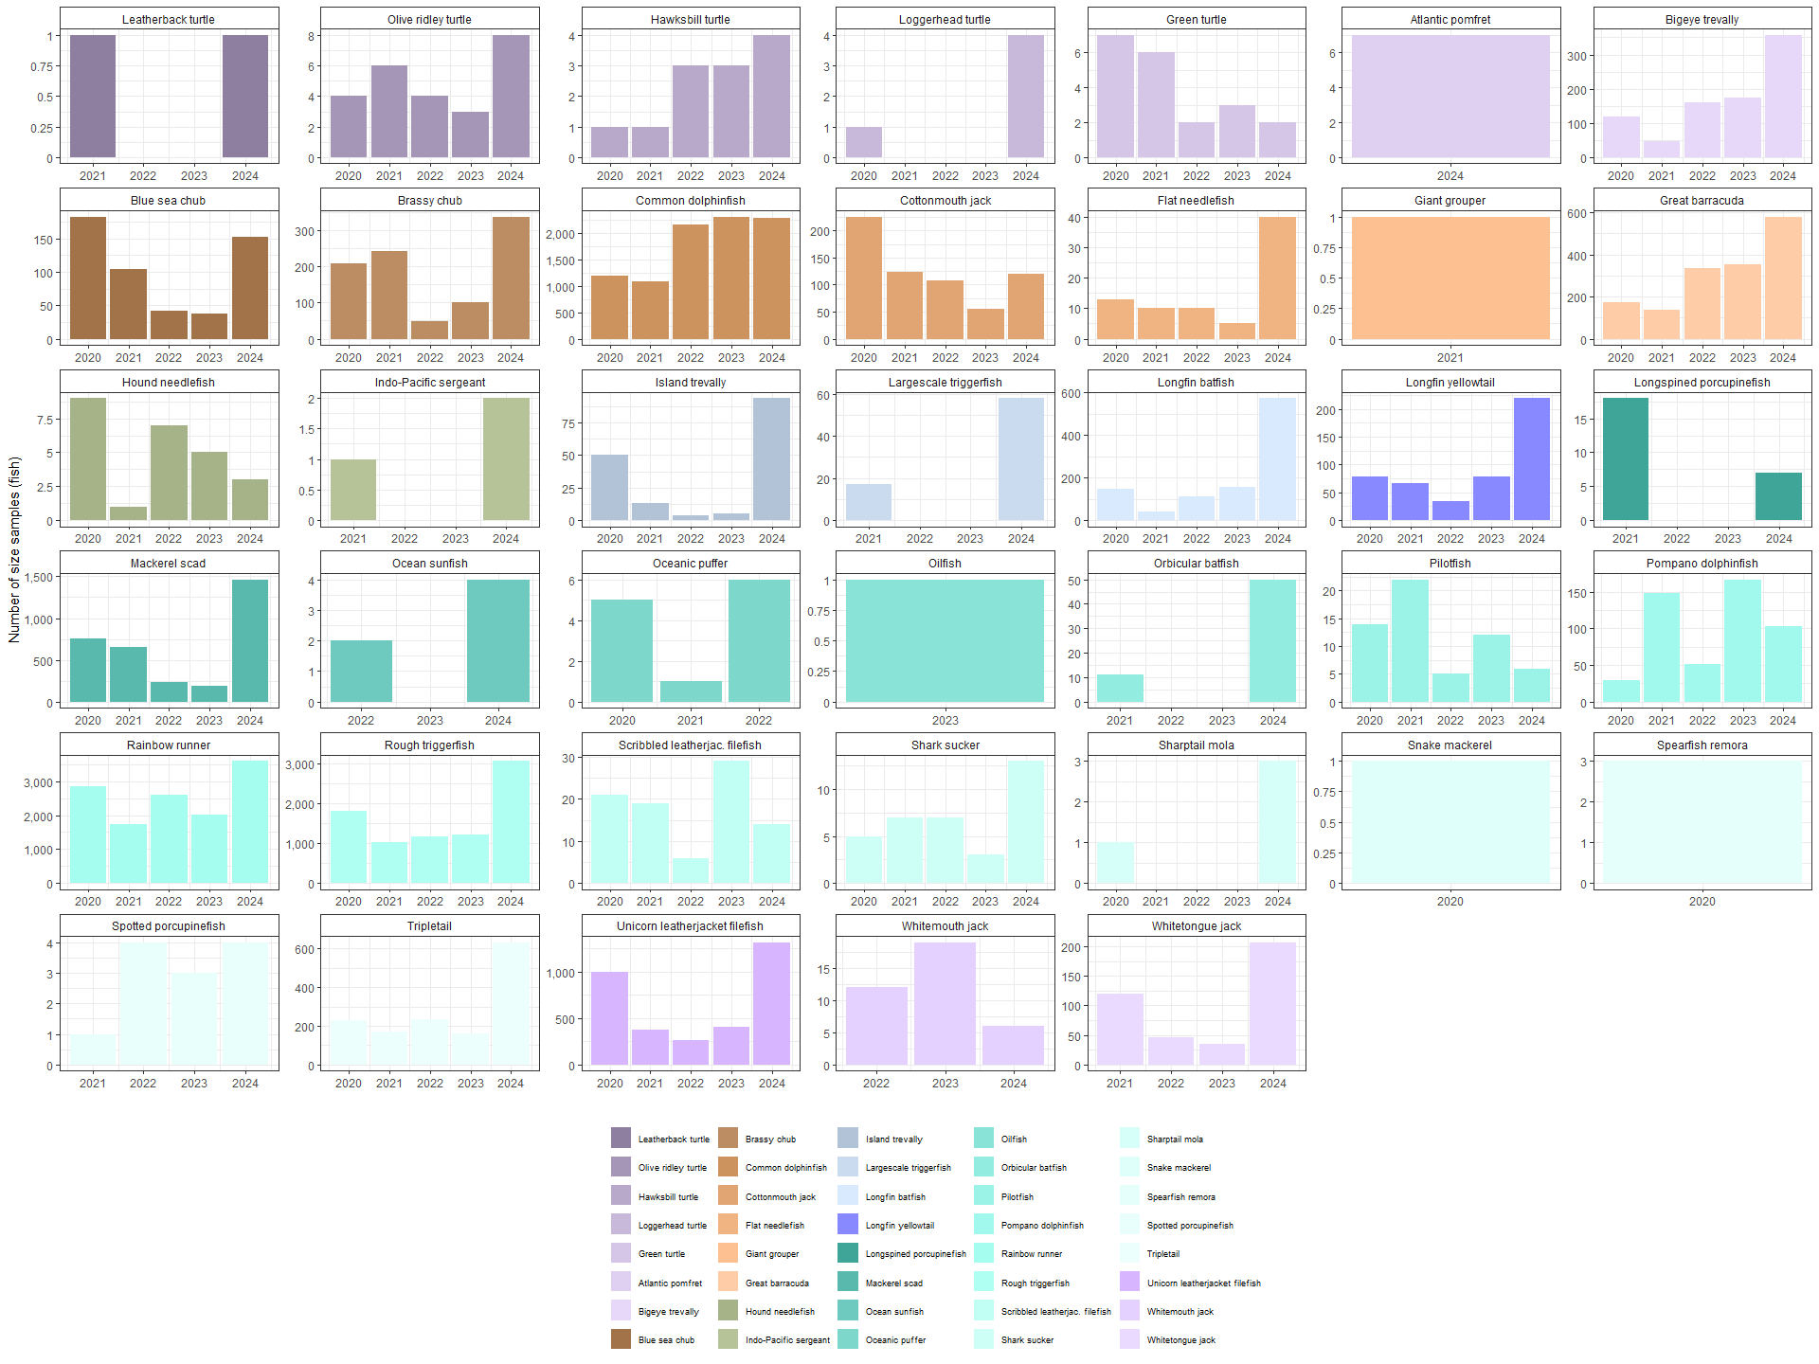
Availability of geo-referenced size frequency - other Non-IOTC species
Other species are also sampling, including species of interest

Slide 11
Reporting of Fishing activities on drifting Aggregated devices
Drifting Aggregated operational data: Provided by most fleets, but reporting requirements not fully met
Buoy Data: thoroughly collected across fleets
CPC code | Fleet | 3DA | 3BU
EU | EU,France | Fully reported | Fully reported
EU | EU,Italy | Fully reported | Fully reported
EU | EU,Spain | Fully reported | Fully reported
OMN | Oman | Partially reported | Fully reported
KOR | Rep. of Korea | Partially reported | Fully reported
MUS | Mauritius | Fully reported | Fully reported
SYC | Seychelles | Fully reported | Fully reported
TZA | Tanzania | Partially reported | Fully reported
KEN | Kenya | Partially reported | Partially reported

Slide 12
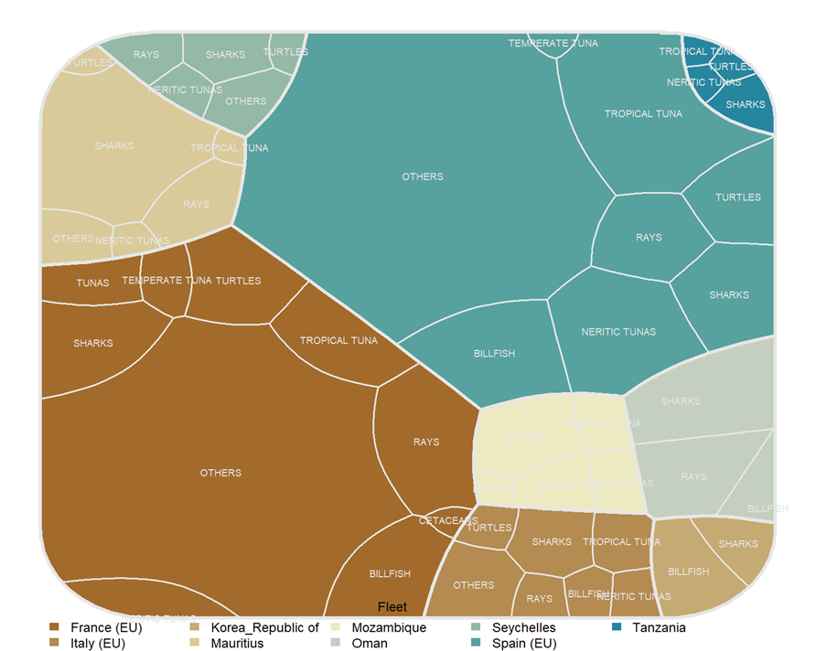
Availability of discarded catch by fleet
Discarded Catches: Reported across fleets, species vary
Reporting Quality: Level of detail inconsistent
Data Format: Often reported in numbers, not raised Some round‑weight data raised to total catch

