Slide 1
Discussion Paper on Labour standards for fishing vessels in IOTC fisheries
30th Session of the Indian Ocean Tuna Commission
P. Cacaud, Independent Legal Consultant
Maldives
May 2026

Slide 2
Structure of the Study on Labour Standards for Fishing Vessels in IOTC Fisheries
International Labour Standards for fishers
Comparative review of crew labour standards for fishers in RFMOs and benchmarking against C188
Review of national legislation governing labour standards for fishing vessels in selected countries
Transferable best practices and lessons learned
Practical Roadmap for improving labour conditions across IOTC fleets

Slide 3
International labour standards for fishers
1982 Convention on the Law of the Sea
International fisheries instruments
(1993 Compliance Agreement, 1995 UN Fish Stock Agreement, 2009 PSMA, CCRF)
IMO Conventions
1995 STCW-F, 2012 Cape Town Agreement
ILO Conventions
(1930 Forced Labour Convention and its 2014 Protocol, 2007 Work in Fishing Convention)
Promotion of fisher’s social rights in regional conventions and other instruments applicable in IOTC area of competence

Slide 4

New labour standards for the fishing sector
The Work in Fishing Convention, 2007 (no. 188)
Till 2006, many fishers benefited from the protection of ILO standards for maritime work applicable to seafarers employed on board merchant ships which, for some of them, could also apply to the fishing sector.
The new Maritime Labour Convention (MLC) adopted in 2006 excludes fishing vessels from its scope.
To date, C188 has been ratified by 25 countries, including 5 IOTC Contracting Parties (France, Kenya, South Africa, Thailand and UK). With the adoption of Presidential Regulation No.4/2026 Indonesia has completed the internal ratification process of C188 and will soon deposit its instruments of ratification with the ILO Director-General

Slide 5
C188 Objectives
The Convention aims at ensuring that fishers have decent conditions of work on board fishing vessels with regard to:
Minimum requirements for work on board
Conditions of service
Accommodation and food
Occupational safety and health protection
Medical care and social security

Slide 6
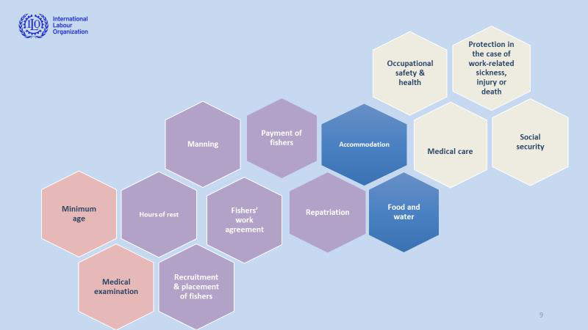

Slide 7
Comparative review of crew labour standards for fishing vessels in RFMOs
Out of the 17 existing RFMOs, 5, including 2 tuna RFMOs, have adopted measures on crew protection or labour standards for fishing vessels
WCPFC was the 1st RFMO to adopt a non-binding measure on labour standards for crew on fishing vessels in 2018
Since then, both ICCAT and NAFO adopted a non-binding measure on core principles on labour standards in 2023
In 2024, WCPFC was the 1st RFMO to pass a binding CMM for crew labour standards (CMM 2024-04)
In 2024, both SPRFMO and NPFC adopted a non-binding measure on labour standards on fishing vessels

Slide 8
Conclusions of comparative review and benchmarking against C188
Labour requirements currently enshrined in relevant RFMOs’ measures are below the minimum labour standards set out in C188
The five measures are silent on the issues of minimum age, medical examination, manning, crew list and social security
Recognition that all fishers need to be protected by an individual work agreement. None of the measures provide for the particulars to be included in a fisher’s work agreement as a minimum
Regulation of recruitment and placement services to ensure adequate protection of migrant fishers
Develop appropriate OSH measures that are adapted to the type of fishing operations
All 5 measures require vessel owners to provide appropriate insurance to fishers covering work-related injury, illness and death
It is the responsibility of the flag State to ensure compliance with applicable labour standards for fishing vessels flying its flag through regular inspections
Port State inspections of foreign-flagged fishing vessels calling at their designated ports

Slide 9
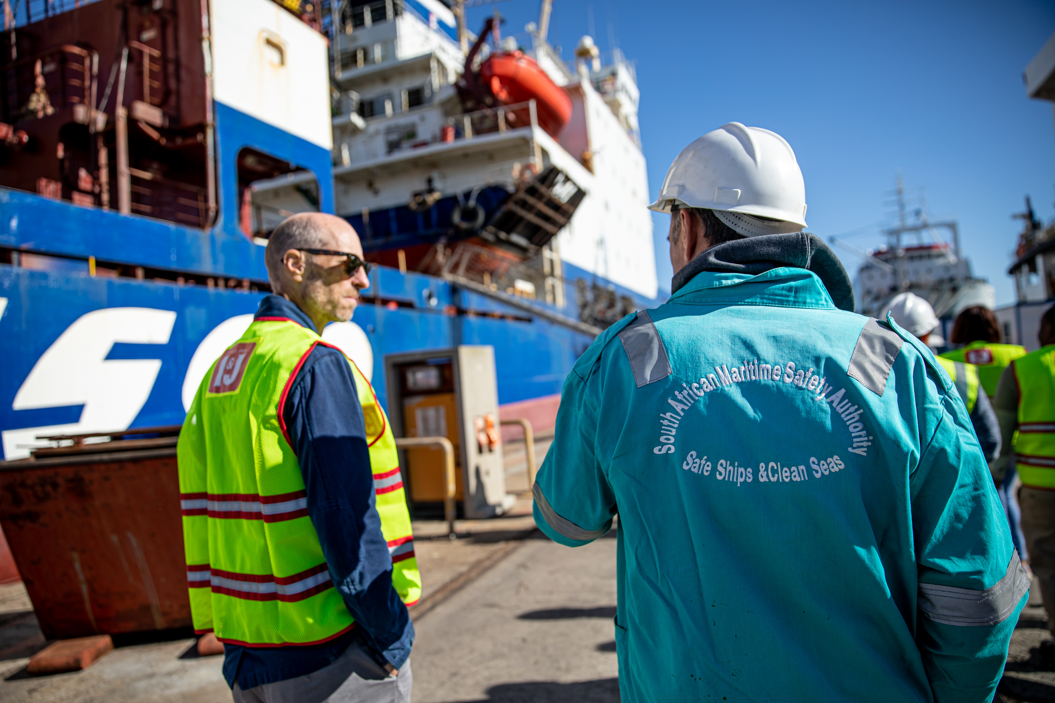
Lessons learned at the national level (Spain, South Africa and Thailand)
Need to develop a clear policy to promote decent work and the protection of fishers’ rights in the fishing sector
Establish well-defined labour standards for fishing vessels (fragmentation over several laws and regulations)
Conduct regular inspections of labour standards on national vessels (condition for licensing)
Strengthen port State inspections of foreign-flagged vessels to detect labour rights’ violations and situations of forced labour (mechanism for cooperation btw relevant agencies)

Slide 10
Transferable best practices and Lessons learned
Promotion of decent work and protection of fishers’ labour rights is an integral part of fisheries management and thus fall within the mandate of RFMOs
Develop a policy framework at the regional level to ensure that IOTC fleets meet the global minimum labour standard for fishing vessels laid out in C188
Ensure adequate protection of migrant fishers’ rights in IOTC fisheries through the promotion of fair recruitment practices, including the sharing of information on recruitment and placement services
Integrate labour inspections of fishing vessels in port State control schemes (joint inspections, referral mechanisms, mecanisms for cooperation, plan of action, training, protection of victims of forced labour)

Slide 11
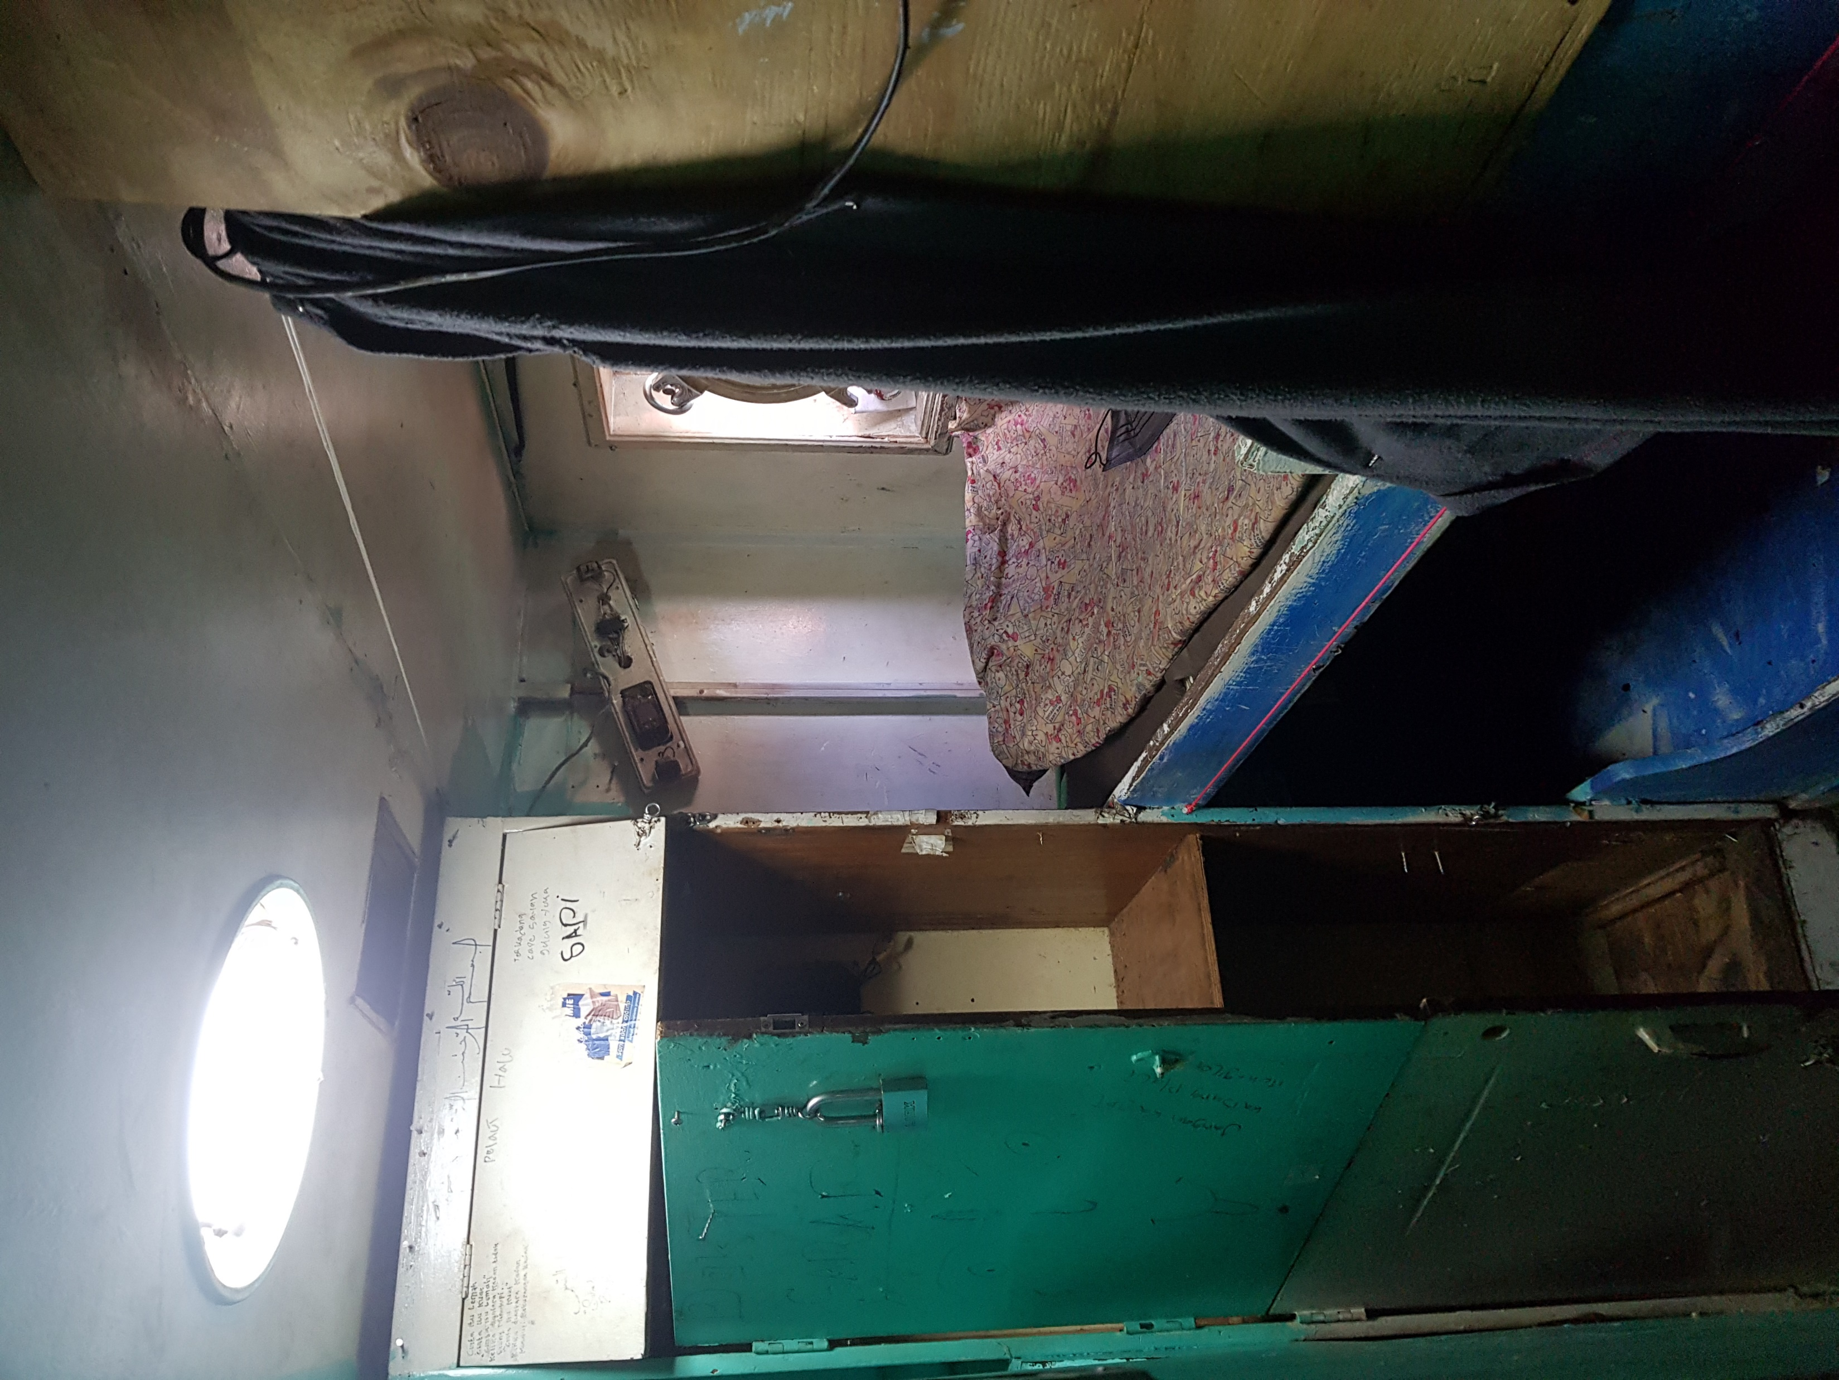
Other Important issues that have not been addressed in RFMOs’ measures
Maximum time that can be spent at sea by any crew member without taking shore leave
Rest periods – minimum standard set out in C188 and mechanism to monitor working hours/rest periods
Reporting of crew changes in port and of transfer of crew at sea (e.g. procedure to ensure safety)

Slide 12
Practical roadmap for improving labour conditions across IOTC fleets and integrating labour standards into the IOTC framework
Prepare a Recommendation to establish a Working Group on labour standards for adoption at the 2027 IOTC Annual Meeting
Hold 1st meeting of the WG in July/August 2027 (elect Chairperson, open to all CPCs, determine whether to adopt a Recommendation or a Resolution)
Finalize a proposal for a Recommendation or Resolution on crew labour standards to be submitted for adoption at 2029 IOTC Annual Meeting
Hold intersessional meetings as agreed and report progress on advancement of the draft measure at 2028 IOTC Annual Meeting
Reporting on the measures taken at the national level to implement the Recommendation or Resolution

Slide 13
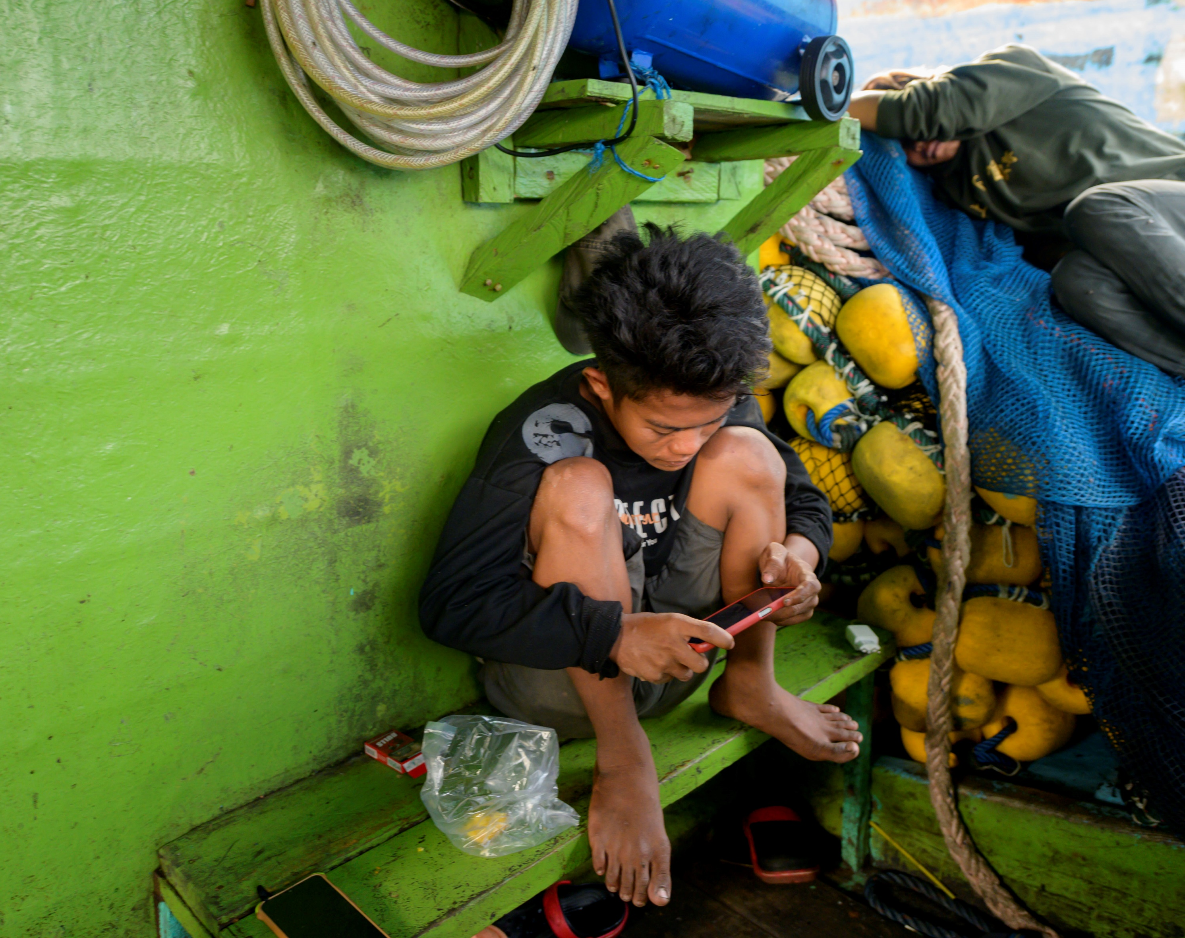
Thank you for your attention

