Slide 1


Reporting data to the IOTC
ROSLLRW - Johannesburg, South Africa - 26-29 May 2026
IOTC-Secretariat@fao.org

Slide 2
The IOTC has developed and implemented several Conservation and Management Measures (CMMs) containing some provisions on the nature and characteristics of the data that must be collected and reported to the IOTC Secretariat.
It is a national responsibility to develop and implement data recording and reporting systems that address the requirements of the IOTC defined through the CMM and the Secretariat is in responsibility of the collation and curation of the different datasets that support the IOTC scientific process.

Slide 3
IOTC CMMs relevant to data collection and reporting
Resolutions 15/01 and 15/02 set the standards in terms of what operational data should be collected at national level and how this has to be aggregated and reported to the IOTC Secretariat.
Resolution 12/02 specifies the minimum confidentiality policies to ensure that sensitive data is not publicly disseminated – unless properly aggregated – once it is received by the Secretariat.

Slide 4
IOTC CMMs relevant to data collection and reporting
18/05 On management measures for the conservation of the billfishes
18/07 On measures applicable in case of non-fulfilment of reporting obligations in the IOTC
21/01 On an interim plan for rebuilding the Indian Ocean yellowfin tuna stock
24/02 On management of drifting fish aggregating devices (FADS)
23/01 On management of anchored fish aggregating devices (AFADS)
12/04 On the conservation of marine turtles
23/07 On reducing incidental bycatch of seabirds in LL fisheries
23/06 On the conservation of cetaceans
19/03 On the conservation of mobulid rays
25/06 On a Regional Observer Scheme
23/08 On Electronic monitoring standards for IOTC fisheries
25/08 On the conservation of sharks caught in association with fisheries managed by IOTC
25/09 On the conservation of shortfin and longfin mako sharks caught in association with IOTC fisheries

Slide 5
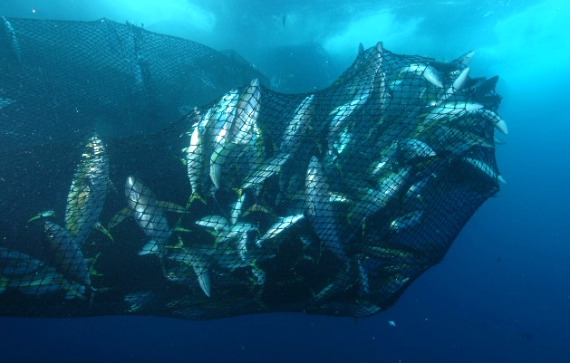
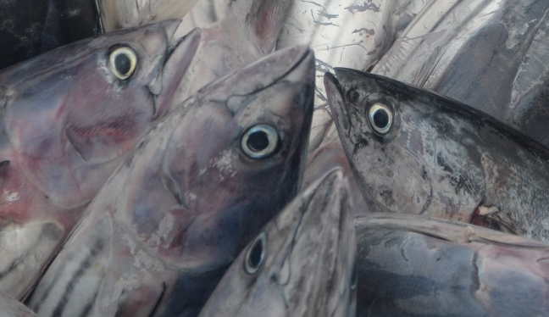
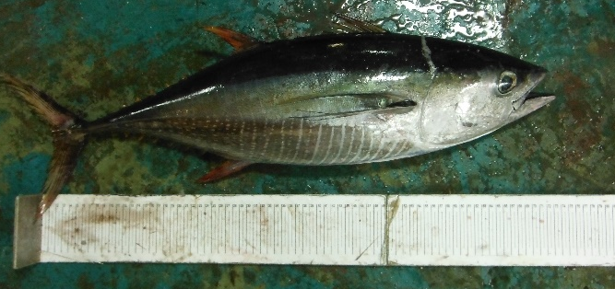
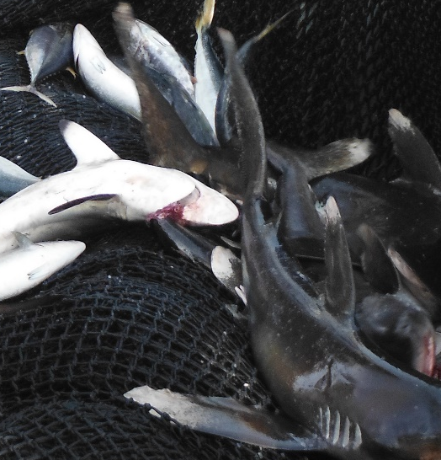
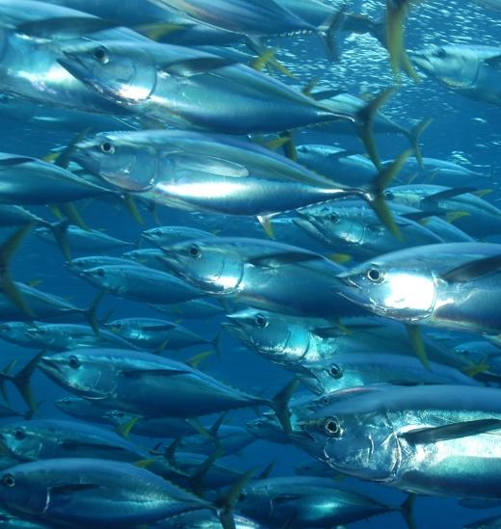
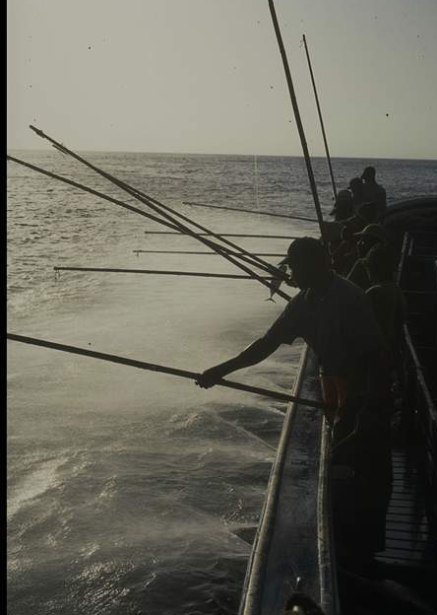
Datasets
And reporting flow

Slide 6




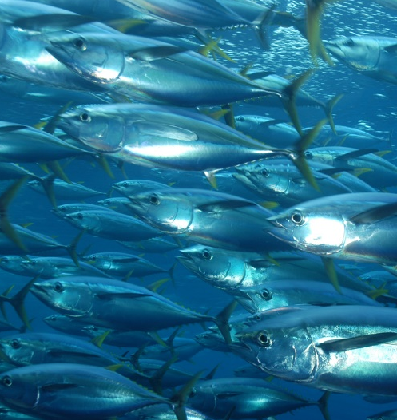
Datasets
And reporting flow

Slide 7
what is the catch made of?
Species presence in the catch
Matrix of presence of species in the retained catches and discards of each fishing fleet by gear group and broad fishery category
CMMs: 15/01, 18/07
Form: 1DR

Slide 8
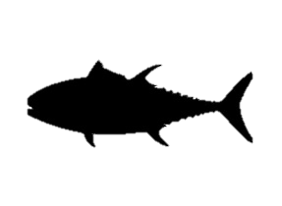
what is retained onboard?
Amount of fish caught and retained
Total annual estimates of the amount of fish caught and retained by fishing fleet, fishery, IOTC main area, retain reason, and species
CMMs: 15/01, 15/02, 18/05,
19/03, 25/08, 25/09
Form: 1RC

Slide 9


what is discarded at sea?
Amount of fish caught and discarded
Total annual estimates of the amount of fish caught and discarded by fishing fleet, fishery, IOTC main area, discard reason, species, and condition at release
CMMs: 15/01, 15/02, 18/05,
19/03, 25/08, 25/09
Form: 1DI

Slide 10
where, when, and how does the fishery operate?
Geo-referenced catches and efforts
Estimates of species-specific catches and efforts by fishing fleet, fishery, and space and time strata
CMMs: 15/01, 15/02, 18/05,
19/03, 25/08, 25/09
Form: 3CE

Slide 11

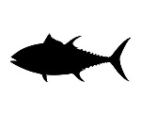
Fishing on Anchored Fish Aggregating Devices
afad-related activities
Daily activities conducted around AFADs, including catches retained and discarded
  CMMs: 15/01, 23/01
  Form: 3AA

Slide 12



Fishing on Drifting Fish Aggregating Devices?
Dfob-related activities
CMMs: 15/01, 15/02, 24/02
Form: 3DA
Daily buoy positions
  CMMs: 19/02 (Oman), 24/02
  Form: 3BU

Slide 13

What is the size composition of the catch?
Geo-referenced size frequencies
Monthly estimates of size-frequencies of the catch retained and discarded by fishing fleet, fishery, area, species, and sex
CMMs: 15/01, 15/02, 18/05,
19/03, 25/08, 25/09
Form: 4SF

Slide 14
Thank you for your attention!
IOTC-Secretariat@fao.org

