Slide 1


IOTC–2026–PSDR–09
IOTC regional observer scheme
Alternative Formats & Data Gaps
IOTC LL ROS Data reporting workshop
25-29 May, Cape Town, South Africa

Slide 2
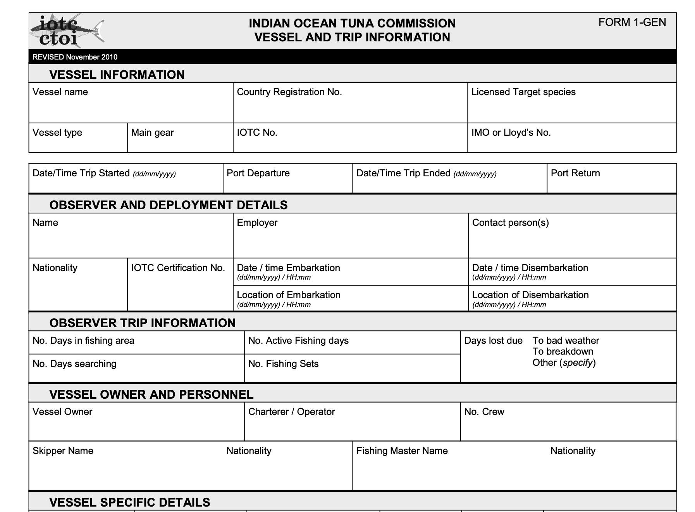
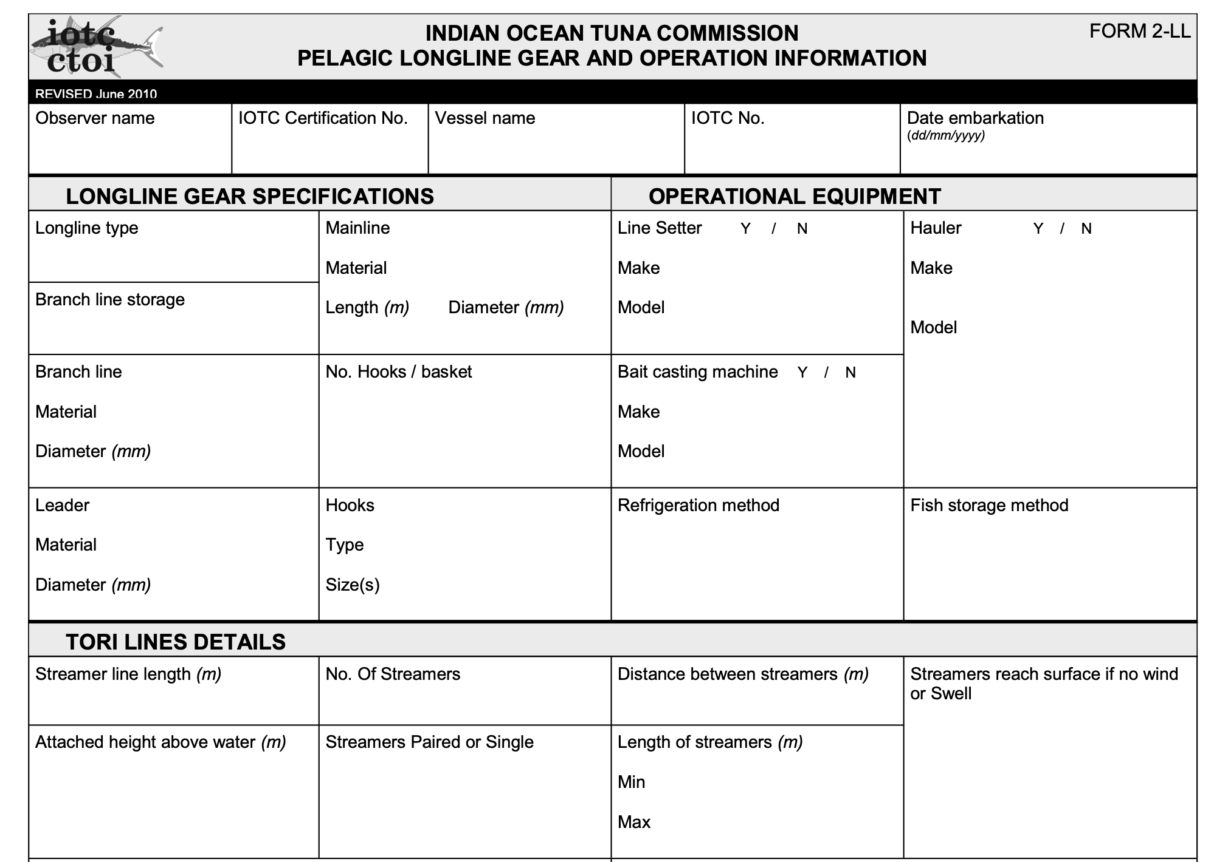
IOTC–2026–PSDR–09
Version 1 – 2010 form
These forms are broken into 6 different pdfs
  Some general
  Some LL specific
Tables to fill out manually
Not connected to code lists
https://zenodo.org/records/17090246

Slide 3
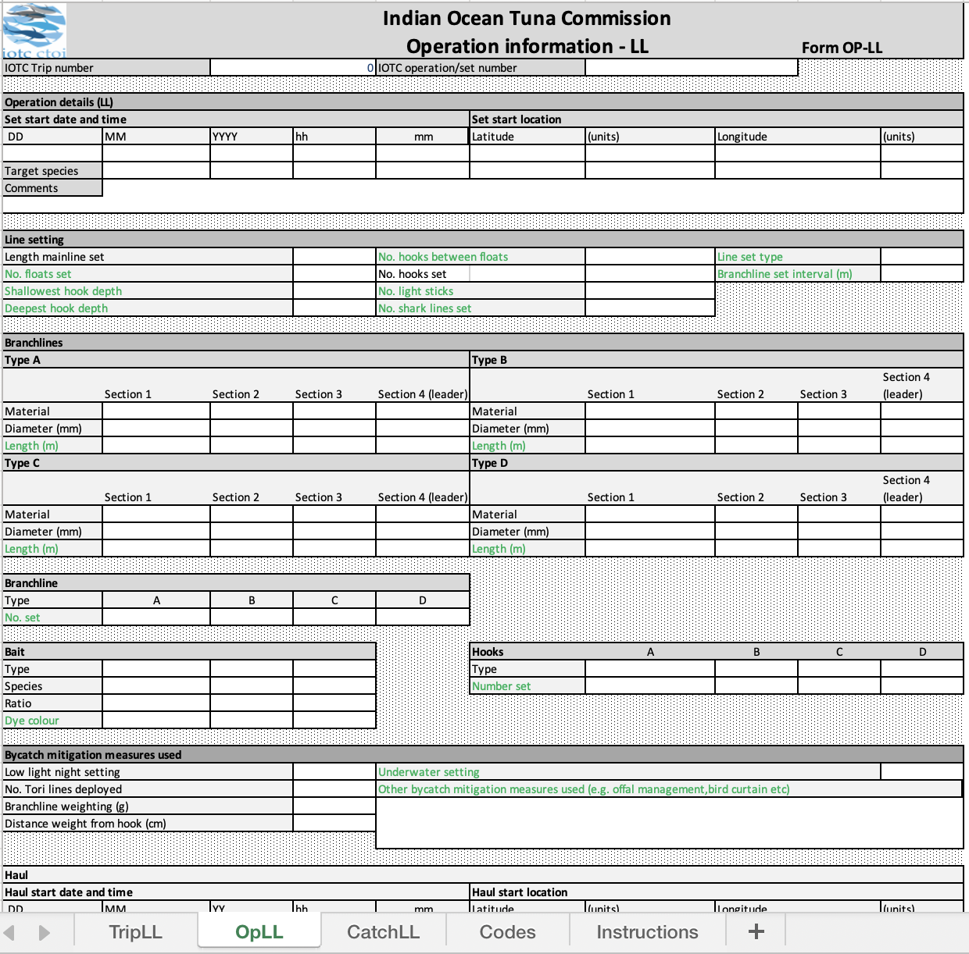
IOTC–2026–PSDR–09
Version 2 – 2015 form
Switched to Excel template
Still in a table format
3 data levels
  Trip, operations, catch
Introducing mandatory and optional fields
https://zenodo.org/records/17181947

Slide 4
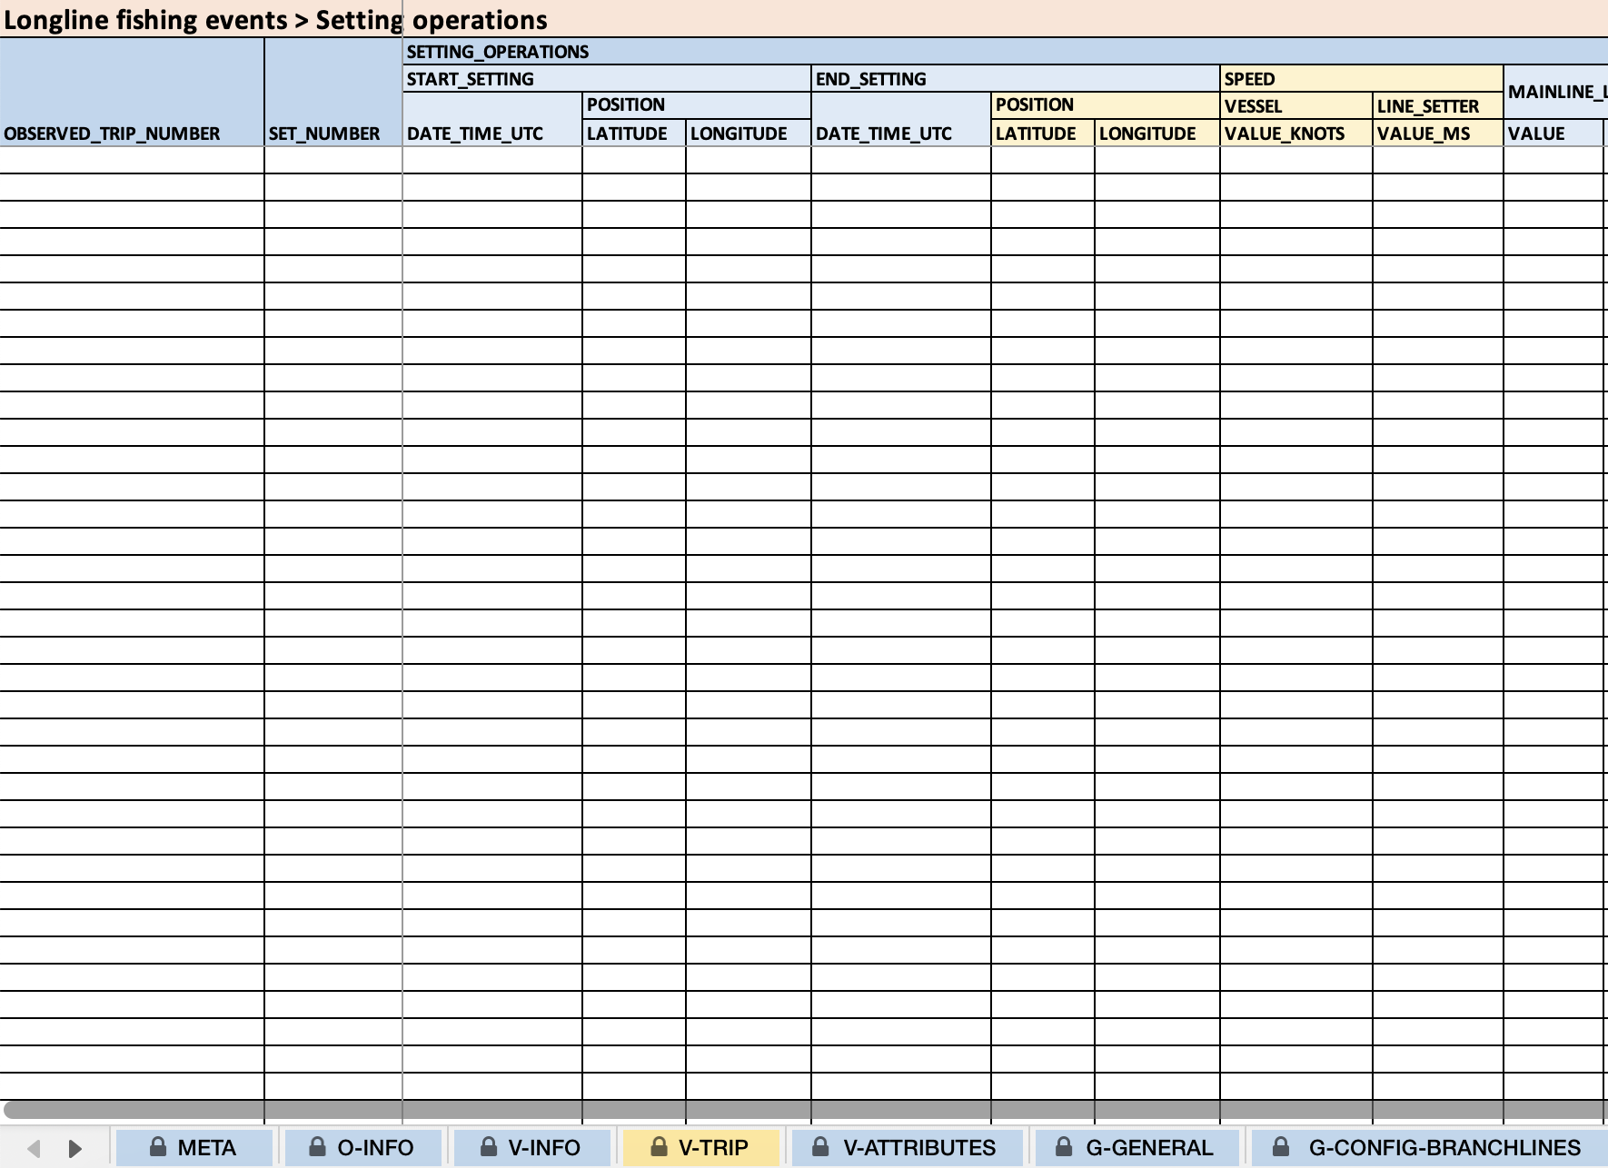
IOTC–2026–PSDR–09
Version 3 – 2022 form
New excel template
Improved sheet organization
"mandatory when available" status for fields
https://zenodo.org/records/17191683

Slide 5
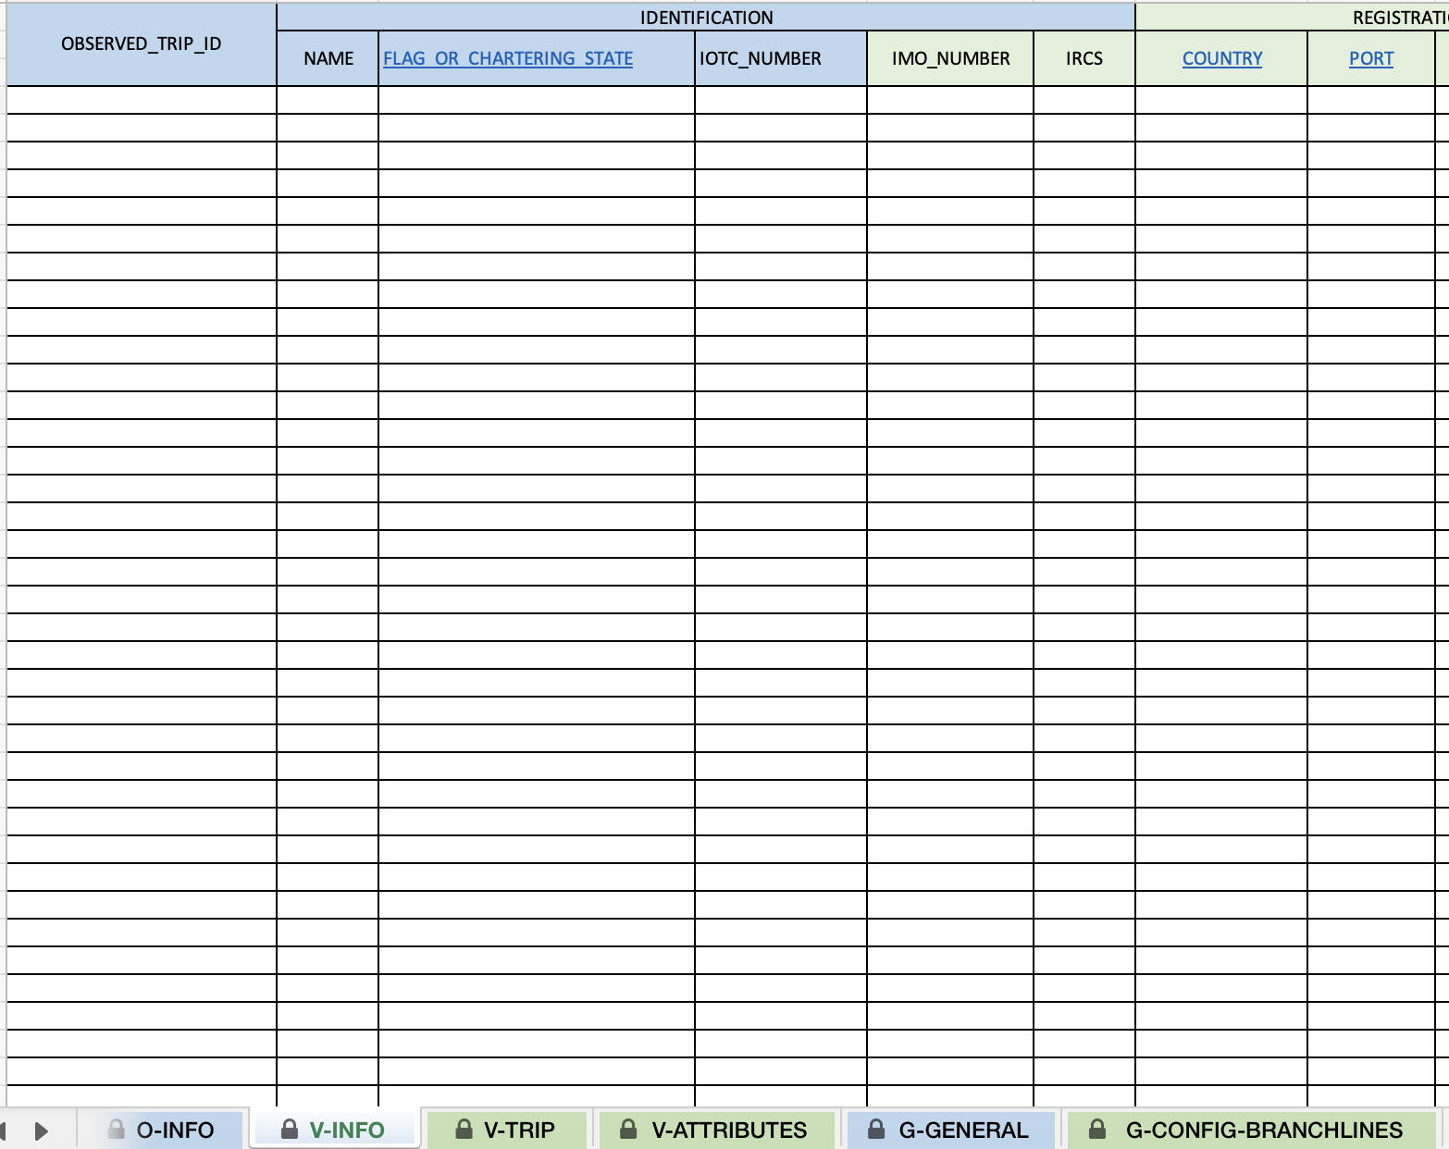
IOTC–2026–PSDR–09
Version 4 – 2025 form
Current version
Simplifying fields
Revised reporting status of fields
https://zenodo.org/records/17509753

Slide 6
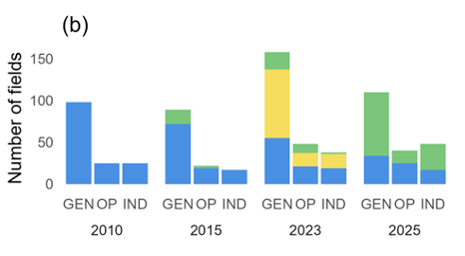
IOTC–2026–PSDR–09
Form Evolution
Changes in number of fields
Changes in structure
Changes in reporting status for fields

Slide 7
IOTC–2026–PSDR–09
Submitted Data (2010 – 2023)
1055 observer reports submitted from 16 fleets
  677 trip reports and submissions from 14 fleets (outside the database)
  378 submissions in the database
    ST09
    Excel files
    E-ROS reporting tools

Slide 8
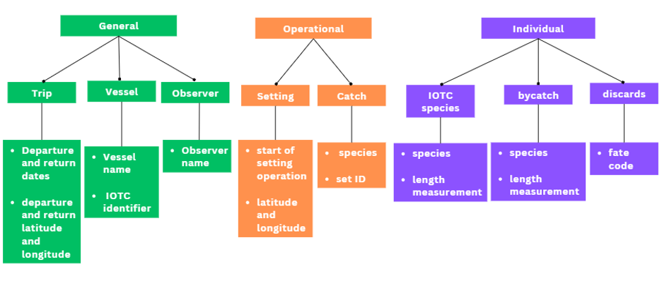
IOTC–2026–PSDR–09
Data Categories
Data were divided into 8 categories across 3 levels
Used to evaluate completeness in reported data

Slide 9
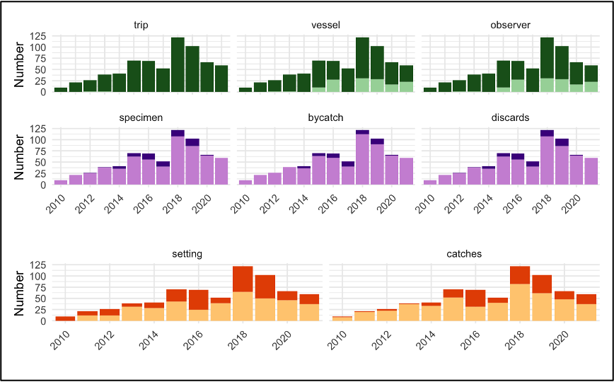
IOTC–2026–PSDR–09
Data (not in database)
General data – largely complete
  Vessel and observer data complete in 80% of submissions
Operational data mostly incomplete
  Most common error was aggregating data by trip
Individual level mostly incomplete
  11% reported data for tuna and discards
  8% provided bycatch data

Slide 10
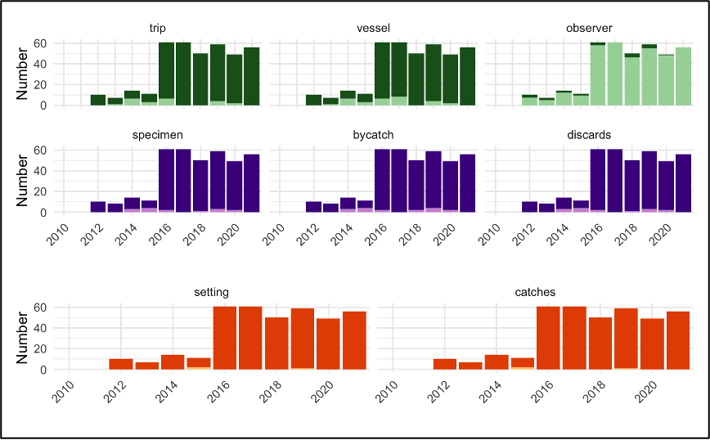
IOTC–2026–PSDR–09
Data (in the database)
Increase in forms due to ST09
General level – mostly complete
  observer data in 5.5% of submissions
  missing from ST09 form
Operational – 99% complete
Individual – 98% complete
However - very few individuals reported
  370 retained individuals in the whole database
  "reason for discard" data largely "UN"

Slide 11
IOTC–2026–PSDR–09
Key Obstacles
CPCs are not reporting with ROS Reporting forms
  Raises issues because other formats do not match IOTC ROS requirements
    Ex. ST09 lacks observer data
For individual level data, there are data for VERY FEW individuals
  This restricts the usability and reliability of data
  Prevents IOTC from using data to verify catches
Reported data is non-descript
  A large portion of data, while complete, is entered as "UN"

