Slide 1


IOTC–2026–PSDR–09
IOTC Regional Observer Scheme
forms and Data Elements
IOTC LL ROS Data reporting workshop
26-29 May, Cape Town, South Africa

Slide 2
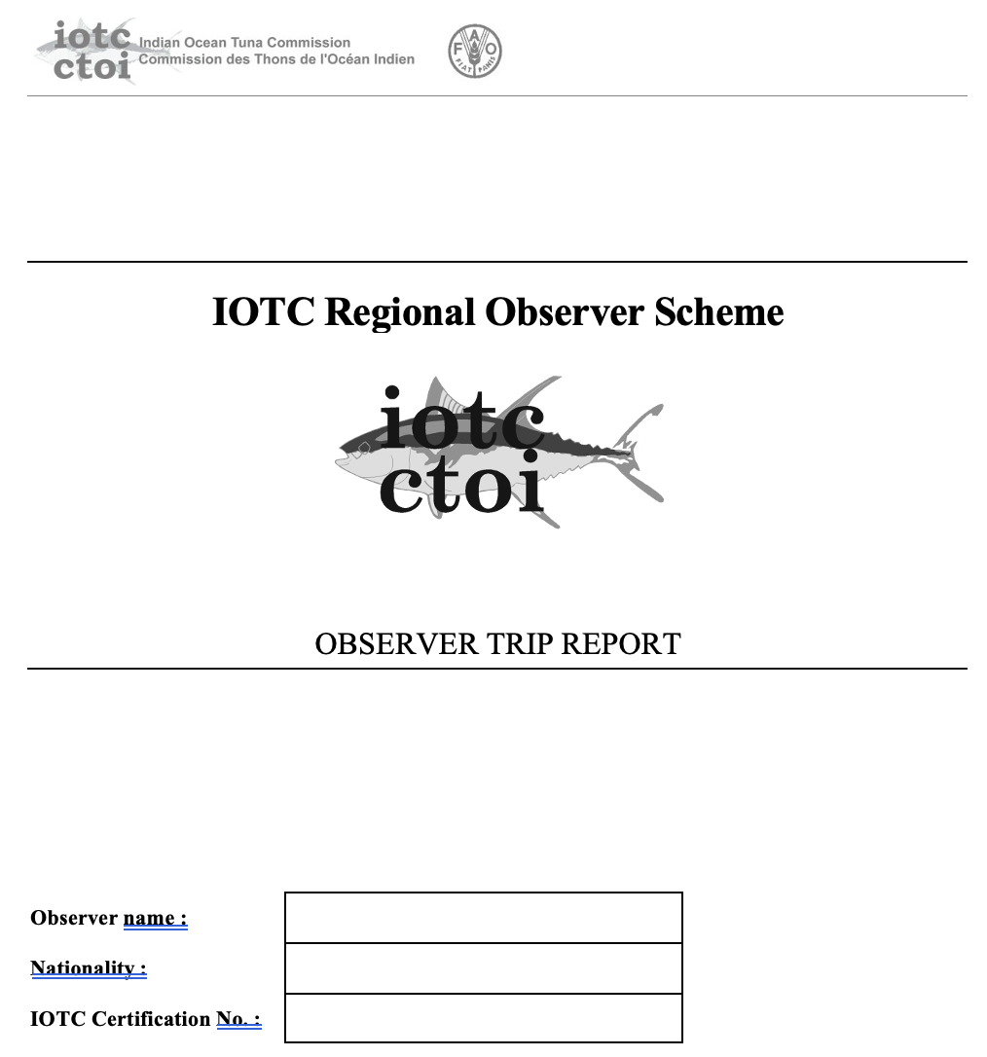
IOTC–2026–PSDR–09
Background
CPCs are responsible for reporting ROS data each year with both IOTC Trip Reports and ROS Reporting Forms
IOTC Trip reports
  Similar to the reporting form, but not as detailed or data centric
  Can be found on the IOTC website

Slide 3
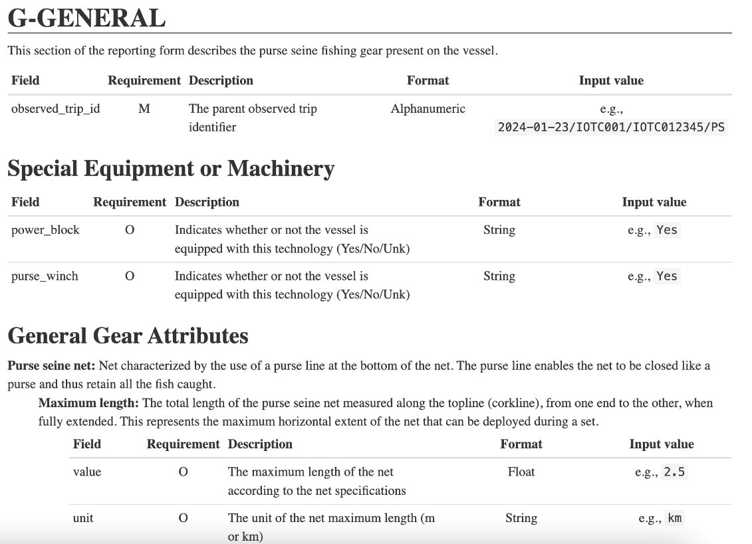
IOTC–2026–PSDR–09
IOTC – ROS Form Descriptions
Data reporting resource to aid in data accuracy and completeness
Defines and describes each field as written in reporting from
Gives reporting requirement level
Provide links to each code list
Give examples of acceptable entries
for each field

Slide 4
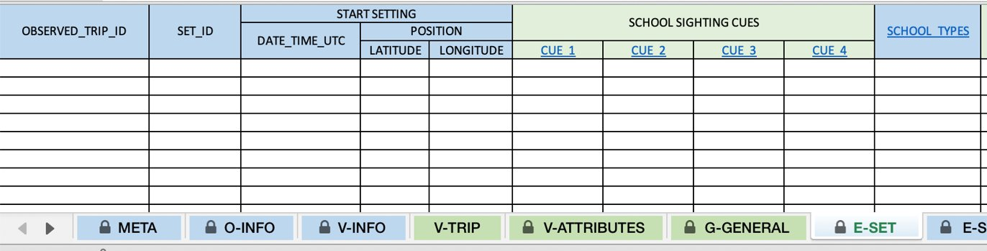
IOTC–2026–PSDR–09
Form Structure
  Sections and subsections separated by Excel sheets
  Unique Identifiers for the trip
  Requirements of fields (mandatory vs optional)
  Code lists linked in individual column headers
Common Sections vs Gear-specific sections
  First sections are common for reporting forms of all gear types
  Subsequent sections are specific to longline fishing operations

Slide 5
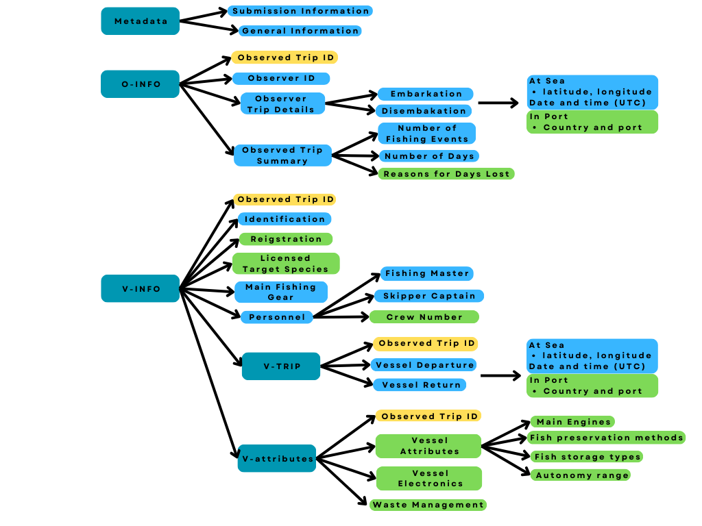
IOTC–2026–PSDR–09
Metadata
Contact details, year, flag
O-INFO – Observer Information
Unique Identifiers: Observed Trip ID
- Observer Trip Details
  Location and date for start and end of observer trip
- Observed Trip Summary
  Summary of trip events and activities

Slide 6
IOTC–2026–PSDR–09
V-INFO – Vessel Information
  Unique Identifiers: Observed trip ID
  Vessel information
    data for vessel identification, gear onboard, and personnel details
  V-TRIP –Trip details
    Location and date for start and end of the vessels trip
  Vessel attributes
    Characteristics of the vessel which describe capacity for activities

Slide 7
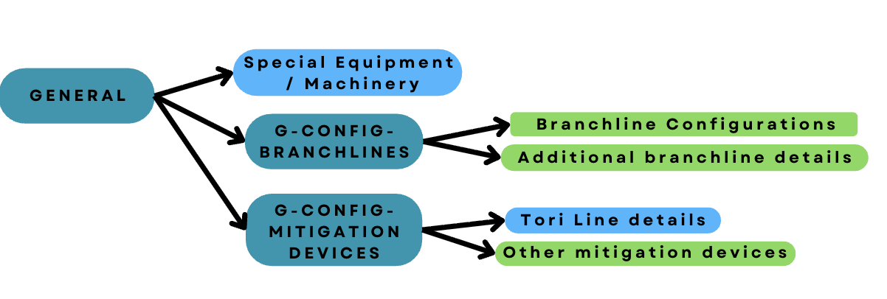
IOTC–2026–PSDR–09
General
Unique identifier
  Observed trip ID
Specific to longline fishing operations

Slide 8
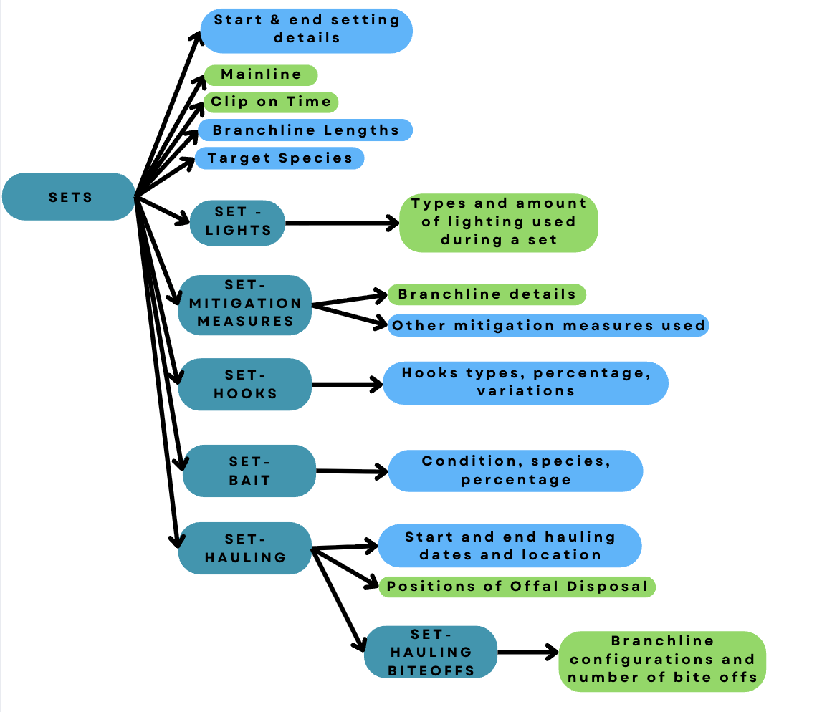
IOTC–2026–PSDR–09
Setting - Operations
  Unique Identifiers
    Observed trip ID
    Set ID
  Setting details and operations
  Mitigation measures, hooks, bait: mandtory data for reporting
  Hauling Operations
  Time and location
  Biteoff data

Slide 9
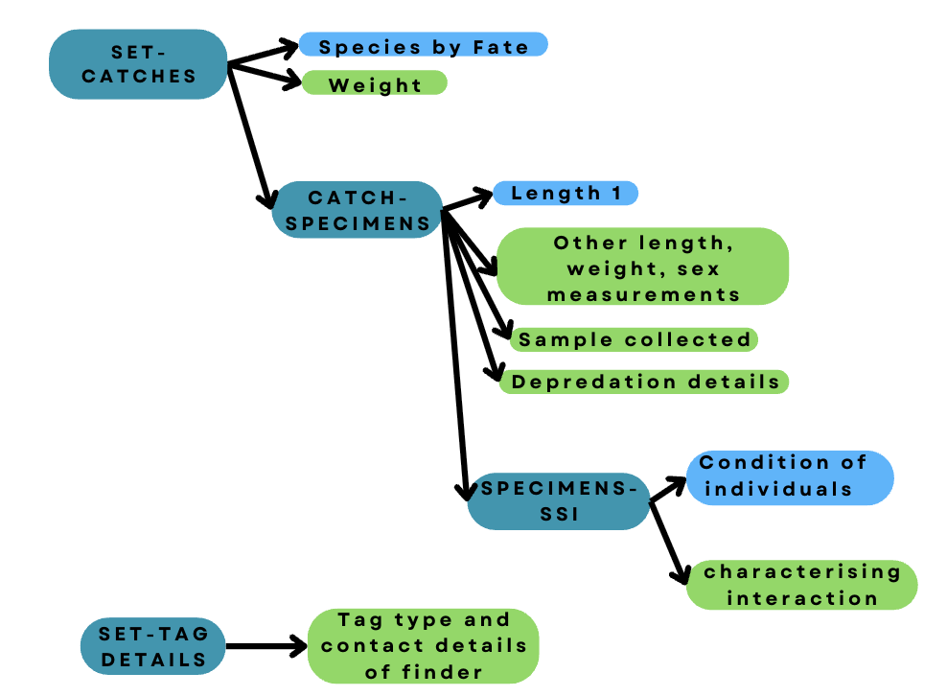
IOTC–2026–PSDR–09
Catch data for each set
  Unique identifiers:
    Observed trip ID
    Set ID
Catches
  Catch ID
    Catch by species
    Specimen ID
      Specimen data
        Species of Special Interest (SSIs)
      Tag details

Slide 10
IOTC–2026–PSDR–09
Thank you for your attention!
Questions?

Slide 11
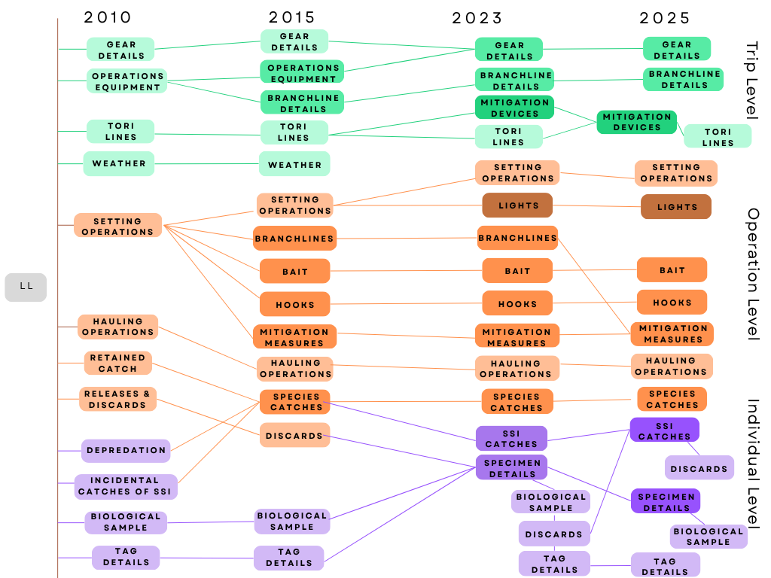
IOTC–2026–PSDR–09
ROS Reporting form evolution
  Forms were initially released in 2010
    Updated in 2015 and 2023
  2024 Scientific Committee made recommendations for revisions.
  (IOTC-2024-SC-DATA01)
  Revised forms released in 2025

